Slide 1

HDF Put/Get Data Directly to/from HDFS
GetHDFS
PutHDFS
ListHDFS
HDF Instance
HDFS
HDF Instance
CreateHadoopSequenceFile
FetchHDFS
GetHDFSSequenceFile
Provide locations of Hadoop Configuration Files to the processors: hdfs-site.xml, core-site.xml.
Hdfs File/Directory path to read/write
*Optional: Kerbros Keytab + Principal is connecting to kerberised environment
Notes:
1) FetchHDFS:
Retrieves a file from HDFS. The content of the incoming FlowFile is replaced by the content of the file in HDFS.
The file in HDFS is left intact without any changes being made to it.
2) GetHDFS:
Fetch files from Hadoop Distributed File System (HDFS) into FlowFiles.
This Processor will delete the file from HDFS after fetching it.
3) GetHDFSSequenceFile
Fetch sequence files from Hadoop Distributed File System (HDFS) into FlowFiles
4) ListHDFS
Retrieves a listing of files from HDFS.
For each file that is listed in HDFS, creates a FlowFile that represents the HDFS file so that it can be fetched in conjunction with ListHDFS.
This Processor is designed to run on Primary Node only in a cluster.
If the primary node changes, the new Primary Node will pick up where the previous node left off without duplicating all of the data.
Unlike GetHDFS, this Processor does not delete any data from HDFS.
5) PutHDFS
Write FlowFile data to Hadoop Distributed File System (HDFS)
1

Slide 2

HDF Can Store/Read Data to Solr
HDF Instance
PutSolrContentStream
GetSolr
HDF Instance
Provide type and url of Solr Instance [zookeeper url if cloud type]
Collection Name if cloud type
Path to post ContentStream and type of content [eg : Json]
Solr query and Filter options for GetSolr
Notes:
1) PutSolrContentStream
Sends the contents of a FlowFile as a ContentStream to Solr
This processor streams the contents of a FlowFile to an Apache Solr update handler.
Any properties added to this processor by the user are passed to Solr on the update request.
If a parameter must be sent multiple times with different values, properties can follow a naming convention: name.number, where name is the parameter name and number is a unique number.
Repeating parameters will be sorted by their property name.
2) GetSolr
Queries Solr and outputs the results as a FlowFile
1

Slide 3

HDF Can Store/Read Data to Hive
PutHiveStreaming
HDF Instance
SelectHiveQL
HDF Instance
PutHiveQL
Create a HiveConnection Pool to connect to Hive Server
SelectHiveQL queries Hive Tables and provide output in Avro or CSV format.
PutHiveQL executes a DDL/DML command on a hive DB
PutHiveStreaming Uses Hive Streaming to sent FlowFile data to Hive Tables.
Notes:
1) PutSolrContentStream
Sends the contents of a FlowFile as a ContentStream to Solr
This processor streams the contents of a FlowFile to an Apache Solr update handler.
Any properties added to this processor by the user are passed to Solr on the update request.
If a parameter must be sent multiple times with different values, properties can follow a naming convention: name.number, where name is the parameter name and number is a unique number.
Repeating parameters will be sorted by their property name.
2) GetSolr
Queries Solr and outputs the results as a FlowFile
1

Slide 4



HDF Can Push/Read messages to Kafka
PublishKafka
ConsumeKafka
HDF Instance
Kafka
HDF Instance
PutKafka
GetKafka
Provide zookeeper Connection String associated with Kafka cluster to GetKafka
Provide Topic name
Provide Kafka Broker list, Topic and Partition to PutKafka.
Notes:
1) PutKafka
Sends the contents of a FlowFile as a message to Apache Kafka.
The messages to send may be individual FlowFiles or may be delimited, using a user-specified delimiter, such as a new-line.
This Processors puts the contents of a FlowFile to a Topic in Apache Kafka.
The full contents of a FlowFile becomes the contents of a single message in Kafka. This message is optionally assigned a key by using the <Kafka Key> Property.
The Processor allows the user to configure an optional Message Delimiter that can be used to send many messages per FlowFile.
For example, a \n could be used to indicate that the contents of the FlowFile should be used to send one message per line of text. If the property is not set, the entire contents of the FlowFile will be sent as a single message. When using the delimiter, if some messages are successfully sent but other messages fail to send, the FlowFile will be FORKed into two child FlowFiles, with the successfully sent messages being routed to 'success' and the messages that could not be sent going to 'failure'.
2) GetKafka
Fetches messages from Apache Kafka.
This Processors polls Apache Kafka for data.
When a message is received from Kafka, this Processor emits a FlowFile where the content of the FlowFile is the value of the Kafka message.
If the message has a key associated with it, an attribute named kafka.key will be added to the FlowFile, with the value being the UTF-8 Encoded value of the Message's Key.
Kafka supports the notion of a Consumer Group when pulling messages in order to provide scalability while still offering a publish-subscribe interface.
Each Consumer Group must have a unique identifier. The Consumer Group identifier that is used by NiFi is the UUID of the Processor.
This means that all of the nodes within a cluster will use the same Consumer Group Identifier so that they do not receive duplicate data but multiple GetKafka Processors can be used to pull from multiple Topics, as each Processor will receive a different Processor UUID and therefore a different Consumer Group Identifier.
1

Slide 5
HDF Expose Streaming data to Spark
Spark pull data from port
HDF Instance
With Site-2-site
Output port
nifi-spark-receiver
Configure HDF to run Site-2-Site
Create an Output Port
Configure Spark Application to run with NiFi-Spark-Receiver and Site-2-Site Client
Spark Will start pulling Steam Data from the NiFi port.
Notes:
Publishing Data to Spark Streaming
Spark doesn't supply a mechanism to have data pushed to it - instead, it wants to pull data from other sources.
NiFi uses its mechanism for transferring data between clusters or instances called Site-to-Site to let Spark Pull Data from It.
NiFi comes with a spark-receiver plugin for each version which should be deployed at your spark application side. [along with your other libraries if required –eg: site-to-site client]
At NiFi end, this data can be exposed in such a way that a receiver can pull from it by adding an Output Port to the root process group.
In order for this to work, we need two pieces of information: the URL to connect to NiFi and the name of the Output Port to pull data from.
SiteToSiteClientConfig config = new SiteToSiteClient.Builder()
.url("http://localhost:8080/nifi") // NiFi Url
.portName(”SPARK") // NiFi Output Port which exposes data
.buildConfig();
This gives us a JavaReceiverInputDStream of type NiFiDataPacket.
The NiFiDataPacket is a simple construct that packages an arbitrary byte array with a map of Key/Value pairs (referred to as attributes) that correspond to the data.
We can extract data as well as NiFi attributes from NiFiDataPacket.
2) Find tutorial under below url:
https://community.hortonworks.com/articles/12708/nifi-feeding-data-to-spark-streaming.html
3) More Reading:
https://blogs.apache.org/nifi/entry/stream_processing_nifi_and_spark
1

Slide 6
HDF Expose data to Storm Directly
Storm pull data from port
HDF Instance
With Site-2-site
Output port
NiFi-Storm-Spout
Storm
Configure HDF to run Site-2-Site
Create an Output Port
Configure Storm Application to run with NiFi-Storm-Spout and Site-2-Site Client
Storm Will start pulling data from the NiFi port.
Notes:
HDF Expose data to Storm Directly
The NiFiSpout provides a way to pull data from Apache NiFi so that it can be processed by Apache Storm.
The NiFi Spout connects to a NiFi instance provided in the config and requests data from the OutputPort that is named.
In NiFi, when an OutputPort is added to the root process group, it acts as a queue of data for remote clients.
This spout is then able to pull that data from NiFi reliably.
Reference:
https://issues.apache.org/jira/browse/NIFI-606
https://github.com/apache/nifi/tree/master/nifi-external/nifi-storm-spout/src/main/java/org/apache/nifi/storm
1

Slide 7

HDF Stores/Reads date to Hbase
ExecuteSQL
Phoenix
PutSQL
PutHbaseShell
HDF Instance
GetHbase
Hbase
HDF Instance
PutHBaseJSON
Configure Hbase Client Service and Distributed Cache Services
Provide Table names and Column Information etc to connect to pull and push data.
You can use Phoenix jdbc connect to query Hbase via regular SQl connectors.
Notes:
1) GetHBase
This Processor polls HBase for any records in the specified table.
The processor keeps track of the timestamp of the cells that it receives, so that as new records are pushed to HBase, they will automatically be pulled.
Each record is output in JSON format, as {"row": "<row key>", "cells": { "<column 1 family>:<column 1 qualifier>": "<cell 1 value>", "<column 2 family>:<column 2 qualifier>": "<cell 2 value>", ... }}.
For each record received, a Provenance RECEIVE event is emitted with the format hbase://<table name>/<row key>, where <row key> is the UTF-8 encoded value of the row's key.
2) PutHBaseCell
Adds the Contents of a FlowFile to HBase as the value of a single cell
3) PutHBaseJSON
Adds rows to HBase based on the contents of incoming JSON documents.
Each FlowFile must contain a single UTF-8 encoded JSON document, and any FlowFiles where the root element is not a single document will be routed to failure.
Each JSON field name and value will become a column qualifier and value of the HBase row.
Any fields with a null value will be skipped, and fields with a complex value will be handled according to the Complex Field Strategy.
The row id can be specified either directly on the processor through the Row Identifier property, or can be extracted from the JSON document by specifying the Row Identifier Field Name property.
This processor will hold the contents of all FlowFiles for the given batch in memory at one time.
1

Slide 8
HDF Best Practices
Notes:
1

Slide 9
HDF Best Practices
Its Important to understand your Data flow's behavior when it comes to Resource consumption.
NiFi is pre-configured to run with very minimal configuration to get started.
This may get you up and running, but that basic configuration is far from ideal for high volume/high performance dataflows.
Some NiFi processors can be CPU, I/O or memory intensive.
In fact some can be intensive in all three areas.
Here we will focus on the areas where you can improve performance by changing some out of the box default values.
Notes:
HDF Best Practices
As data flows through your dataflow in NiFi, it is important to understand how well your system is performing in order to assess if you will require more resources and in order to assess the health of your current resources.
NiFi is pre-configured to run with very minimal configuration needed out of the box.
Simply edit the nifi.properties file located in the conf directory by adding a sensitive props key and you are ready to go.
This may get you up and running, but that basic configuration is far from ideal for high volume/high performance dataflows.
Some NiFi processors can be CPU, I/O or memory intensive.
In fact some can be intensive in all three areas.
Here we will focus on the initial setup of the application itself and focus on the areas where you can improve performance by changing some out of the box default values.
We have tried to identify if a processor is intensive in any of these areas within the processor documentation.
This guide is not intended to cover how to optimize your data flow design or how to fine-tune your individual processors.
1

Slide 10
nifi.properties file
We will start by looking at the nifi.properties file located in the conf directory of the NiFi installation.
The file is broken up into following sections
Core Properties
H2 Settings
FlowFile Repository
Content Repository
Provenance Repository
Component Status Repository
Site to Site properties
Web Properties
Security properties and
Cluster properties
The various properties that make up each of these sections come pre-configured with default values.
Notes:
nifi.properties file
We will start by looking at the nifi.properties file located in the conf directory of the NiFi installation.
The file is broken up in to sections (Core Properties, H2 Settings, FlowFile Repository, Content Repository, Provenance Repository, Component Status Repository, Site to Site properties, Web Properties, Security properties, and Cluster properties).
The various properties that make up each of these sections come pre-configured with default values.
1

Slide 11
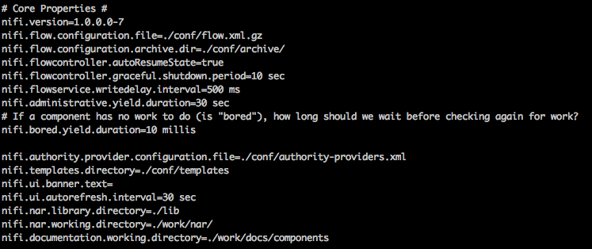
nifi.properties - Core Properties
1) nifi.bored.yield.duration [Default value is 10 millis]
This property is designed to help with CPU utilization by preventing processors, that are using the timer driven scheduling strategy, from using excessive CPU when there is no work to do.
The default 10-millisecond value already makes a huge impact on cutting down on CPU utilization.
Smaller values equate to lower latency, but higher CPU utilization.
So depending on how important latency is to your overall dataflow, increasing the value here will cut down on overall CPU utilization even further.
Notes:
nifi.properties - Core Properties
In the Core Properties section there is only one property in this section that has an impact on NiFi, performance: nifi.bored.yield.duration
This property is designed to help with CPU utilization by preventing processors, that are using the timer driven scheduling strategy, from using excessive CPU when there is no work to do.
The default 10-millisecond value already makes a huge impact on cutting down on CPU utilization.
Smaller values equate to lower latency, but higher CPU utilization.
So depending on how important latency is to your overall dataflow, increasing the value here will cut down on overall CPU utilization even further.
1

Slide 12
nifi.properties - Core Properties (Cont..)
2) nifi.ui.autorefresh.interval [Default Value is 30 sec]
It does not have an impact on NiFi performance but can have an impact on browser performance.
This property sets the value at which the latest statistics, bulletins and flow revisions will be refreshed pushed to connected browser sessions.
In order to reload the complete dataflow the user must trigger a refresh.
Decreasing the time between refreshes will allow bulletins to present themselves to the user in a timelier manner; however, doing so will increase the network bandwidth used.
The number of concurrent users accessing the UI compounds this.
We suggest keeping the default value and only changing it if closer to real–time bulletin or statistics reporting in the UI is needed.
The user can always manually trigger a refresh at any time by right clicking on any open space on the graph and selecting “refresh status”.
Notes:
nifi.properties - Core Properties
There is another property in this section that can be changed for better performance: nifi.ui.autorefresh.interval
It does not have an impact on NiFi performance but can have an impact browser performance.
It does not have an impact on NiFi performance but can have an impact on browser performance.
This property sets the value at which the latest statistics, bulletins and flow revisions will be refreshed pushed to connected browser sessions.
In order to reload the complete dataflow the user must trigger a refresh.
Decreasing the time between refreshes will allow bulletins to present themselves to the user in a timelier manner; however, doing so will increase the network bandwidth used.
The number of concurrent users accessing the UI compounds this.
We suggest keeping the default value and only changing it if closer to real–time bulletin or statistics reporting in the UI is needed.
The user can always manually trigger a refresh at any time by right clicking on any open space on the graph and selecting “refresh status”.
1

Slide 13
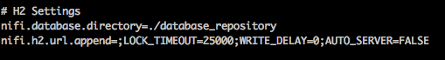
nifi.properties - H2 Settings
There are two H2 databases used by NiFi.
A user DB - keeps track of user logins when the NiFi is secured.
A history DB - keeps track of all changes made on the graph.
They stay relatively small and require very little hard drive space.
The default installation path of <root-level-nifi-dir>/database_repository would result in the directory being created at the root level of your NiFi installation (same level as conf, bin, lib, etc directories).
While there is little to no performance gain by moving this to a new location, we do recommend moving all repositories to a location outside of the NiFi install directories to simplify upgrading.
This allow you retain the user and component history information after upgrading.
Notes:
nifi.properties - H2 Settings
There are two H2 databases used by NiFi.
A user DB - keeps track of user logins when the NiFi is secured.
A history DB - keeps track of all changes made on the graph.
They stay relatively small and require very little hard drive space.
The default installation path of <root-level-nifi-dir>/database_repository would result in the directory being created at the root level of your NiFi installation (same level as conf, bin, lib, etc directories).
While there is little to no performance gain by moving this to a new location, we do recommend moving all repositories to a location outside of the NiFi install directories to simplify upgrading.
This allow you retain the user and component history information after upgrading.
1

Slide 14
nifi.properties - FlowFile Repository
1) nifi.flowfile.repository.directory [Default Value is ./flowfile_repository ]
FlowFile repo maintains state on all FlowFiles located anywhere in the data flows on the NiFi UI.
The most common cause of corruption of FlowFiles are the result of running out of disk space.
The default configuration again has the repository located in <root-level-nifi-dir>/flowfile_repository.
Recommendation is to move this repository out of the base install path.
You will also want to have the FlowFile repository located on a disk (high performance RAID preferably) that is not shared with other high I/O software.
On high performance systems, the FlowFile repository should never be located on the same hard disk/RAID as either the content repository or provenance repository if at all possible.
Notes:
nifi.properties - FlowFile Repository
This is by far the most important repository in NiFi.
It maintains state on all FlowFiles currently located anywhere in the data flows on the NiFi UI.
If it should become corrupt, the potential exists that you could lose access to some or all of the files currently being worked on by NiFi.
The most common cause of corruption is the result of running out of disk space.
The default configuration again has the repository located in <root-level-nifi-dir>/flowfile_repository.
Recommendation is to move this repository out of the base install path.
On high performance systems, the FlowFile repository should never be located on the same hard disk/RAID as either the content repository or provenance repository if at all possible.
1

Slide 15
nifi.properties - FlowFile Repository (Cont..)
2) nifi.queue.swap.threshold [Default Value is 20000 ]
NiFi does not move the physical file (content) from processor to processor, FlowFiles serve as the unit of transfer from one processor to the next.
In order to make that as fast as possible, FlowFiles live inside the JVM memory.
This is great until you have so many FlowFiles in your system that you begin to run out of JVM memory and performance takes a serious dive.
To reduce the likelihood of this happening, NiFi has a threshold that defines how many FlowFiles can live in memory on a single connection queue before being swapped out to disk.
If the number of total FlowFiles in any one-connection queue exceeds this value, swapping will occur.
Depending on how much swapping is occurring, performance can be affected.
If queues having an excess of 20,000 FlowFiles is the norm rather then the occasional data surge for your data flow, it may be wise to increase this value.
Notes:
nifi.queue.swap.threshold
NiFi does not move the physical file (content) from processor to processor, FlowFiles serve as the unit of transfer from one processor to the next. In order to make that as fast as possible, FlowFiles live inside the JVM memory. This is great until you have so many FlowFiles in your system that you begin to run out of JVM memory and performance takes a serious dive. To reduce the likelihood of this happening, NiFi has a threshold that defines how many FlowFiles can live in memory on a single connection queue before being swapped out to disk. Connections are represented in the UI as arrows connecting two processors together. FlowFiles can queue on these connections while waiting for the follow-on processor.
If the number of total FlowFiles in any one-connection queue exceeds this value, swapping will occur. Depending on how much swapping is occurring, performance can be affected. If queues having an excess of 20,000 FlowFiles is the norm rather then the occasional data surge for your data flow, it may be wise to increase this value. You will need to closely monitor your heap memory usage and increase it as well to handle these larger queues. Heap size is set in the bootstrap.conf file that will be discussed later.
1

Slide 16
nifi.properties - Content Repository
1) nifi.content.repository.directory.default [Default Value is ./content_repository ]
Since the content for every FlowFile that is consumed by NiFi is placed inside the content repository, the hard disk that this repository is loaded on will experience high I/O on systems that deal with high data volumes.
As you can see, once again the repository is created by default inside the NiFi installation path.
The content repository should be moved to its own hard disk/RAID.
Sometimes even having a single dedicated high performance RAID is not enough.
NiFi allows you to configure multiple content repositories within a single instance of NiFi.
NiFi will then round robin files to however many content repositories are defined:
nifi.content.repository.directory.contS1R1=/cont-repo1/content_repository
nifi.content.repository.directory.contS1R2=/cont-repo2/content_repository
nifi.content.repository.directory.contS1R3=/cont-repo3/content_repository
In a NiFi cluster, every Node can be configured to use the same names for their various repositories, but it is recommend to use different names.
Notes:
Content Repository
Since the content (the physical file that was ingested by NiFi) for every FlowFile that is consumed by NiFi is placed inside the content repository, the hard disk that this repository is loaded on will experience high I/O on systems that deal with high data volumes. As you can see, once again the repository is created by default inside the NiFi installation path.
nifi.content.repository.directory.default [Default Value is ./content_repository ]
The content repository should be moved to its own hard disk/RAID.
Sometimes even having a single dedicated high performance RAID is not enough.
NiFi allows you to configure multiple content repositories within a single instance of NiFi.
NiFi will then round robin files to however many content repositories are defined:
nifi.content.repository.directory.contS1R1=/cont-repo1/content_repository
nifi.content.repository.directory.contS1R2=/cont-repo2/content_repository
nifi.content.repository.directory.contS1R3=/cont-repo3/content_repository
In a NiFi cluster, every Node can be configured to use the same names for their various repositories, but it is recommend to use different names.
1

Slide 17
nifi.properties - Provenance Repository
1) nifi.provenance.repository.directory.default [Default Value is ./provenance_repository]
Similar to the content repository, the provenance repository can use a large amount of disk I/O for writing and reading provenance events.
Every transaction within the entire dataflow that affects either the FlowFile or content has a provenance event created.
The default configuration has the provenance repository being created inside the NiFi installation path.
It is recommended that the provenance repository is also located on its own hard disk /RAID and does not share its disk with any of the other repositories (database, FlowFile, or content).
Multiple provenance repositories can be defined by providing unique names in place of ‘default’ and paths:
nifi.provenance.repository.directory.provS1R1=/prov-repo1/provenance_repository
nifi.provenance.repository.directory.provS1R2=/prov-repo2/provenance_repository
Notes:
nifi.properties - Provenance Repository
Similar to the content repository, the provenance repository can use a large amount of disk I/O for writing and reading provenance events because every transaction within the entire dataflow the affects either the FlowFile or content has a provenance event created The UI does not restrict the number of users who can make simultaneous queries against the provenance repository. I/O increases with the number of concurrent queries taking place. The default configuration has the provenance repository being created inside the NiFi installation path just like the other repositories:
nifi.provenance.repository.directory.default=./provenance_repository
It is recommended that the provenance repository is also located on its own hard disk /RAID and does not share its disk with any of the other repositories (database, FlowFile, or content). Just like the content repository, multiple provenance repositories can be defined by providing unique names in place of ‘default’ and paths:
nifi.provenance.repository.directory.provS1R1=/prov-repo1/provenance_repository
nifi.provenance.repository.directory.provS1R2=/prov-repo2/provenance_repository
1

Slide 18
nifi.properties - Provenance Repository (Cont..)
2) nifi.provenance.repository.query.threads [The default value is 2 ]
The number of threads that are available to conduct provenance queries is defined by this property.
On systems where numerous users may be making simultaneous queries against the provenance repository, it may be necessary to increase the number of threads allocated to this process.
3) nifi.provenance.repository.index.threads [The default value is 1 ]
The number of threads to use for indexing Provenance events so that they are searchable can be adjusted by editing this.
For flows that operate on a very high number of FlowFiles, the indexing of Provenance events could become a bottleneck.
If this is the case, a bulletin will appear indicating, "The rate of the dataflow is exceeding the provenance recording rate. Slowing down flow to accommodate."
If this happens, increasing the value of this property may increase the rate at which the Provenance Repository is able to process these records, resulting in better overall throughput.
Notes:
nifi.properties - Provenance Repository
The ability to query provenance information on files has great value to a variety of users. The number of threads that are available to conduct provenance queries is defined by:
nifi.provenance.repository.query.threads=2
On systems where numerous users may be making simultaneous queries against the provenance repository, it may be necessary to increase the number of threads allocated to this process. The default value is 2.
The number of threads to use for indexing Provenance events so that they are searchable can be adjusted by editing this line:
nifi.provenance.repository.index.threads=1
The default value is 1. For flows that operate on a very high number of FlowFiles, the indexing of Provenance events could become a bottleneck. If this is the case, a bulletin will appear indicating, "The rate of the dataflow is exceeding the provenance recording rate. Slowing down flow to accommodate." If this happens, increasing the value of this property may increase the rate at which the Provenance Repository is able to process these records, resulting in better overall throughput. Keep in mind that as you increase the number of threads allocated to one process, you reduce the number available to another. So you should leave this at one unless the above error message is encountered.
1

Slide 19
nifi.properties - Provenance Repository (Cont..)
4) nifi.provenance.repository.index.shard.size [The default value is 500MB ]
When provenance queries are performed, the configured shard size has an impact on how much of the heap is used for that process.
Large values for the shard size will result in more Java heap usage when searching the Provenance Repository but should provide better performance.
Default is 500MB, this does not mean that 500 MB of heap is used.
Keep in mind that if you increase the size of the shard, you may also need to increase the size of your overall heap, which is configured in the bootstrap.conf file.
Notes:
Provenance Repository - nifi.provenance.repository.index.shard.size [The default value is 500MB ]
When provenance queries are performed, the configured shard size has an impact on how much of the heap is used for that process:
nifi.provenance.repository.index.shard.size=500 MB
Large values for the shard size will result in more Java heap usage when searching the Provenance Repository but should provide better performance. The default value is 500 MB. This does not mean that 500 MB of heap is used. Keep in mind that if you increase the size of the shard, you may also need to increase the size of your overall heap, which is configured in the bootstrap.conf file discussed later.
1

Slide 20
Bootstrap.conf file
The bootstrap.conf file in the conf directory allows users to configure settings for how NiFi should be started.
This includes parameters, such as the size of the Java Heap, what Java command to run, and Java System Properties.
This files comes pre-configured with default values.
We will focus on just the properties that should be changed when installing NiFi for the purpose of high volume / high performance dataflows.
The bootstrap.conf file is broken in to sections just like the nifi.properties file.
Since NiFi is a Java application it requires that Java be installed. NiFi requires Java 7 or later.
We will only highlight the sections that need changing.
Notes:
Bootstrap.conf file
The bootstrap.conf file in the conf directory allows users to configure settings for how NiFi should be started. This includes parameters, such as the size of the Java Heap, what Java command to run, and Java System Properties. This files comes pre-configured with default values. We will focus on just the properties that should be changed when installing NiFi for the purpose of high volume / high performance dataflows. The bootstrap.conf file is broken in to sections just like the nifi.properties file. Since NiFi is a Java application it requires that Java be installed. NiFi requires Java 7 or later. Some recommended settings only apply if you are using Java 7. We will only highlight the sections that need changing.
1

Slide 21
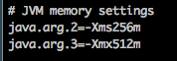
Bootstrap.conf - JVM memory settings
This section is used to control the amount heap memory to use by the JVM running NiFi.
Xms defines the initial memory allocation, while Xmx defines the maximum memory allocation for the JVM.
As you can see the default values are very small and not suitable for dataflows of any substantial size.
We recommend increasing both the initial and maximum heap memory allocations to at least 4 GB or 8 GB for starters.
java.arg.2=-Xms8g java.arg.3=-Xmx8g
If you should encounter any “out of memory” errors in your NiFi app log, this is an indication that you have either a memory leak or simply insufficient memory allocation to support your dataflow.
Notes:
Bootstrap.conf - JVM memory settings
This section is used to control the amount heap memory to use by the JVM running NiFi. Xms defines the initial memory allocation, while Xmx defines the maximum memory allocation for the JVM. As you can see the default values are very small and not suitable for dataflows of any substantial size. We recommend increasing both the initial and maximum heap memory allocations to at least 4 GB or 8 GB for starters.
java.arg.2=-Xms8g java.arg.3=-Xmx8g
If you should encounter any “out of memory” errors in your NiFi app log, this is an indication that you have either a memory leak or simply insufficient memory allocation to support your dataflow. When using large heap allocations, garbage collection can be a performance killer (most noticeable when Major Garbage Collection occurs against the Old Generation objects).
1

Slide 22
Bootstrap.conf - JVM memory settings (Cont..)
When using large heap allocations, garbage collection can be a performance killer (most noticeable when Major Garbage Collection occurs against the Old Generation objects).
When using larger heap sizes it is recommended that a more efficient garbage collector is used to help reduce the impact to performance should major garbage collection occur.
You can configure your NiFi to use the G1 garbage collector by uncommenting the above line. java.arg.13=-XX:+UseG1GC
Notes:
Bootstrap.conf - JVM memory settings
When using large heap allocations, garbage collection can be a performance killer (most noticeable when Major Garbage Collection occurs against the Old Generation objects).
When using larger heap sizes it is recommended that a more efficient garbage collector is used to help reduce the impact to performance should major garbage collection occur.
You can configure your NiFi to use the G1 garbage collector by uncommenting the above line. java.arg.13=-XX:+UseG1GC
1

Slide 23
Bootstrap.conf – Java 8 and above only
Increase the Code Cache size by uncommenting this line:
java.arg.7=-XX:ReservedCodeCacheSize=256m
The code cache is memory separate from the heap that contains all the JVM bytecode for a method compiled down to native code. If the code cache fills, the compiler will be switched off and will not be switched back on again. This will impact the long running performance of NiFi.
The only way to recover performance is a restart the JVM (restart NiFi). So by removing the comment on this line, the code cache size is increased to 256m,which should be sufficient to prevent the cache from filling up.
Below parameter establishes a boundary for how much of the code cache can be used before flushing of the code cache will occur to prevent it from filling and resulting in the stoppage of the compiler.
java.arg.8=-XX:CodeCacheMinimumFreeSpace=10m
java.arg.9=-XX:+UseCodeCacheFlushing
Notes:
1

Slide 24
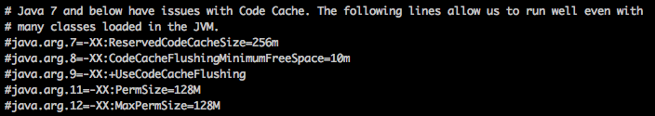
Bootstrap.conf - Java 7 and below only
There is a section in the bootstrap.conf file that includes several commented out Java parameters that can improve performance if you are running with a version of Java 7.
We do not set these values by default because Java 8 was restructured and there is no value in setting them if you are running with Java 8.
Increase the Code Cache size by uncommenting this line:
java.arg.7=-XX:ReservedCodeCacheSize=256m
Notes:
Java 7 and below only
There is a section in the bootstrap.conf file that includes several commented out Java parameters that can improve performance if you are running with a version of Java 7. We do not set these values by default because Java 8 was restructured and there is no value in setting them if you are running with Java 8. - Increase the Code Cache size by uncommenting this line:
java.arg.7=-XX:ReservedCodeCacheSize=256m
The code cache :
The code cache is memory separate from the heap that contains all the JVM bytecode for a method compiled down to native code. If the code cache fills, the compiler will be switched off and will not be switched back on again. This will impact the long running performance of NiFi. The only way to recover performance is a restart the JVM (restart NiFi). So by removing the comment on this line, the code cache size is increased to 256m,which should be sufficient to prevent the cache from filling up. The default code cache is defined by the Java version you are running, but can be as little as 32m.
1

Slide 25
Bootstrap.conf - Java 7 and below only (Cont..)
Following parameter establishes a boundary for how much of the code cache can be used before flushing of the code cache will occur to prevent it from filling and resulting in the stoppage of the compiler.
java.arg.8=-XX:CodeCacheFlushingMinimumFreeSpace=10m java.arg.9=-XX:+UseCodeCacheFlushing
The final two lines cover increasing the default size of the permgen space.
This can be set by removing the comments on the following two lines: java.arg.11=-XX:PermSize=128M java.arg.12=-XX:MaxPermSize=128M
Notes:
Bootstrap.conf - Java 7 and below only
- An additional layer of protection comes by removing the comment on the following 2 lines:
java.arg.8=-XX:CodeCacheFlushingMinimumFreeSpace=10m java.arg.9=-XX:+UseCodeCacheFlushing
- This parameter establishes a boundary for how much of the code cache can be used before flushing of the code cache will occur to prevent it from filling and resulting in the stoppage of the compiler.
The final two lines cover increasing the default size of the permgen space. This can be set by removing the comments on the following two lines: java.arg.11=-XX:PermSize=128M java.arg.12=-XX:MaxPermSize=128M
- The permgen space is where Java 7 class definitions and NiFi class definitions are loaded on startup. The default permgen size is often not large enough to accommodate all these classes being loaded on startup. Depending on the number of classes being loaded, more or less space may be allocated. The value provided above is more then enough to accommodate NiFi’s current classes; however, if you have added additional custom processors/classes, permgen size may need to be increased.
1

Slide 26
SSL User Authentication

Slide 27
Securing NiFi with 2-Way-SSL
NiFi Provides 2-Way-SSL or Mutual SSL Authentication Option to secure NiFi.
Mutual SSL authentication or certificate based mutual authentication refers to two parties authenticating each other through verifying the provided digital certificate so that both parties are assured of the others' identity.
In our terms, it refers to client, a web browser authenticating themselves to a NiFi node and that NiFi node also authenticating itself to the client through verifying the public key certificate/digital certificate issued by the trusted Certificate Authorities (CAs).
Because authentication relies on digital certificates, certification authorities such as Verisign or Microsoft Certificate Server, etc.. are an important part of the mutual authentication process.
Notes:
Securing NiFi
NiFi Provides 2-Way-SSL or Mutual SSL Authentication Option to secure NiFi.
Mutual SSL authentication or certificate based mutual authentication refers to two parties authenticating each other through verifying the provided digital certificate so that both parties are assured of the others' identity.
In our terms, it refers to client, a web browser authenticating themselves to a NiFi node and that NiFi node also authenticating itself to the client through verifying the public key certificate/digital certificate issued by the trusted Certificate Authorities (CAs).
Because authentication relies on digital certificates, certification authorities such as Verisign or Microsoft Certificate Server, etc.. are an important part of the mutual authentication process.
1

Slide 28
2-Way-SSL – How it works
From a high-level point of view, the process of authenticating and establishing an encrypted channel using certificate-based mutual authentication involves the following steps:
A Web Browser client requests access to a protected resource.
The NiFi server presents its certificate to the client.
The client verifies the NiFi server’s certificate.
If successful, the client sends its certificate to the NiFi server.
The NiFi server verifies the client’s credentials.
If successful, the NiFi server grants access to the protected resource requested by the client.
Notes:
2-Way-SSL – Steps Involved
From a high-level point of view, the process of authenticating and establishing an encrypted channel using certificate-based mutual authentication involves the following steps:
A Web Browser client requests access to a protected resource.
The NiFi server presents its certificate to the client.
The client verifies the NiFi server’s certificate.
If successful, the client sends its certificate to the NiFi server.
The NiFi server verifies the client’s credentials.
If successful, the NiFi server grants access to the protected resource requested by the client.
1

Slide 29
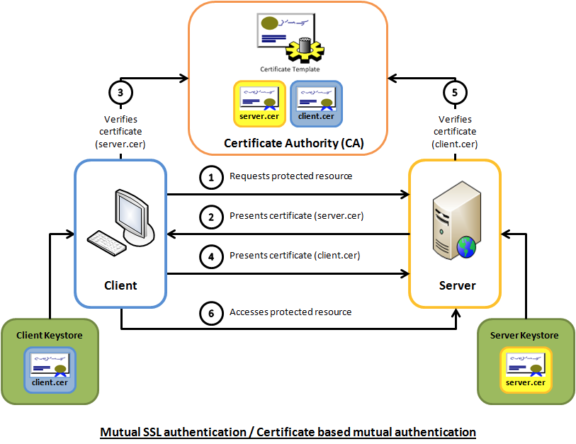
2-Way-SSL – How it works
Notes:
Mutual SSL authentication
Step 1: A Web Browser client requests access to a protected resource.
Step 2: The NiFi server presents its certificate to the client.
Step 3: The client verifies the NiFi server’s certificate.
Step 4: If successful, the client sends its certificate to the NiFi server.
Step 5: The NiFi server verifies the client’s credentials.
Step 6: If successful, the NiFi server grants access to the protected resource requested by the client.
1

Slide 30
Important NiFi SSL Configuration properties
NiFi provides several different configuration options for security purposes.
The most important properties are those under the "security properties" heading in the nifi.properties file. In order to run securely, the following properties must be set:
Property Name | Description
nifi.security.keystore | Keystore that contains the server’s private key.
nifi.security.keystoreType | The type of Keystore. Must be either PKCS12 or JKS.
nifi.security.keystorePasswd | The password for the Keystore.
nifi.security.keyPasswd | The password for the certificate in the Keystore.
nifi.security.truststore | Truststore that will be used to authorize those connecting to NiFi
nifi.security.truststoreType | The type of the Truststore. Must be either PKCS12 or JKS.
nifi.security.truststorePasswd | The password for the Truststore.
nifi.security.needClientAuth | Specifies whether or not connecting clients must authenticate themselves.
Notes:
NiFi Security Configuration
NiFi provides several different configuration options for security purposes.
The most important properties are those under the "security properties" heading in the nifi.properties file. In order to run securely, the following properties must be set:
1

Slide 31
Important NiFi SSL Configuration properties
Once the above properties have been configured, we can enable the User Interface to be accessed over HTTPS instead of HTTP.
This is accomplished by setting the nifi.web.https.host and nifi.web.https.port properties.
The nifi.web.https.host property indicates which hostname the server should run on.
It is important when enabling HTTPS that the nifi.web.http.port property be unset.
Now that the User Interface has been secured, we can easily secure Site-to-Site connections and inner-cluster communications, as well.
This is accomplished by setting the nifi.remote.input.secure and nifi.cluster.protocol.is.secure properties, respectively, to true.
Notes:
Securing NiFi
Once the above properties have been configured, we can enable the User Interface to be accessed over HTTPS instead of HTTP.
This is accomplished by setting the nifi.web.https.host and nifi.web.https.port properties.
The nifi.web.https.host property indicates which hostname the server should run on.
This allows admins to configure the application to run only on specific network interfaces.
If it is desired that the HTTPS interface be accessible from all network interfaces, a value of 0.0.0.0 should be used.
It is important when enabling HTTPS that the nifi.web.http.port property be unset.
Now that the User Interface has been secured, we can easily secure Site-to-Site connections and inner-cluster communications, as well.
This is accomplished by setting the nifi.remote.input.secure and nifi.cluster.protocol.is.secure properties, respectively, to true.
1

Slide 32
NiFi SSL Configuration Options
To configure Certificate based Security in NiFi, administrator have couple of options, they are listed below:
Configure SSL for NiFi with your own certificate
Use NiFi provided TLS Generation Toolkit manually
Use Ambari to Automatically generate Certificates with TLS Generation Toolkit
Notes:
Securing NiFi
To configure Certificate based Security in NiFi, administrator have couple of options, they are listed below:
Configure SSL for NiFi with your own certificate
Use NiFi provided TLS Generation Toolkit manually
Use Ambari to Automatically generate Certificates with TLS Generation Toolkit
1

Slide 33
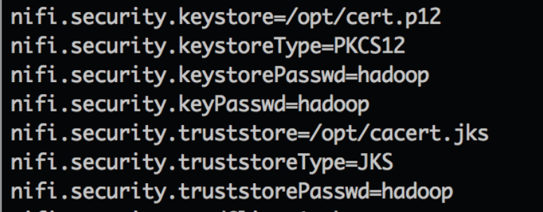
1. Configure SSL for NiFi with your own certificate
To configure NiFi to use external certificates follow below steps
Generate your own Certificates from vendors like Verisign or Microsoft Certificate Server.
Determine an Initial Admin Identity when you configure NiFi for first time.( as well as for each cluster nodes to communicate with each other).
Configure the properties for SSL authentication
Configure properties Manually in the NiFi property files OR
Leverage Ambari to configure NiFi once you have certificates created.
Restart NiFi Manually/via Ambari to make changes take effect.
Login as Initial Admin after loading certificates to browser.
Notes:
1

Slide 34
2. Use NiFi provided TLS Generation Toolkit manually
To use NiFi provided TLS toolkit follow below steps:
Generate Certificates with TLS toolkit, example:
$ bin/tls-toolkit.sh standalone –n ‘node1.hortonworks.com’ -C 'CN=node1,OU=NIFI’
Determine an Initial Admin Identity when you configure NiFi for first time.( as well as for each cluster nodes to communicate with each other).
Configure properties Manually in the NiFi property files
Restart NiFi Manually/via Ambari to make changes take effect.
Login as Initial Admin after loading certificates to browser
Notes:
1

Slide 35
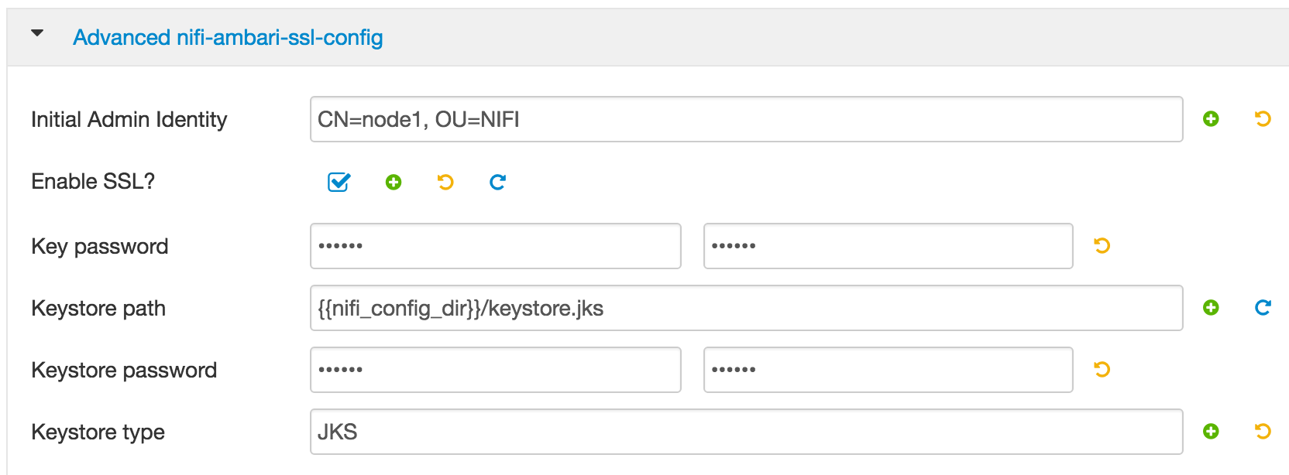
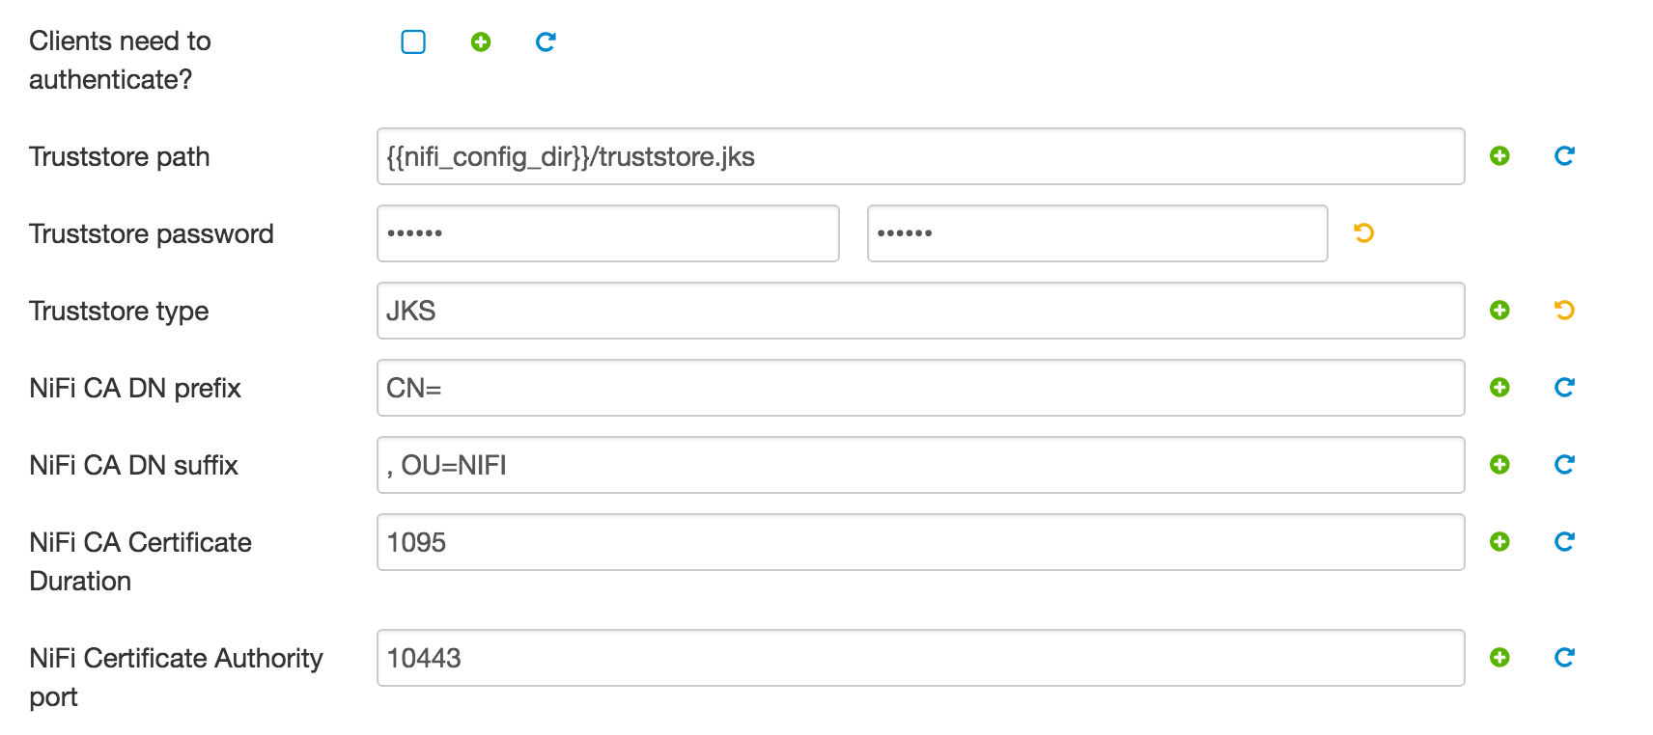
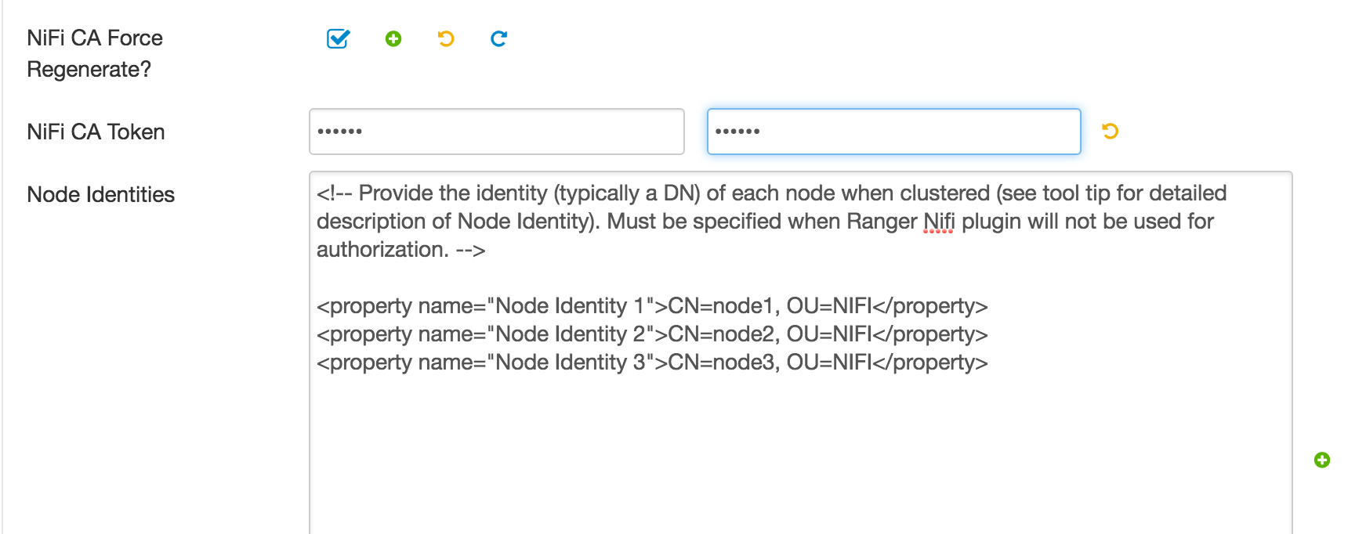
3. Use Ambari to Automatically generate Certificates
To configure NiFi SSL with Ambari, follow below Steps:
In Ambari Select Services → NiFi→ Config → Advanced nifi-ambari-ssl-config
Configure Initial Admin
Enable SSL
Truststore path, type, password
Keystore path,type, password
Force regenerate CA
Cluster node Identities
Notes:
1

Slide 36
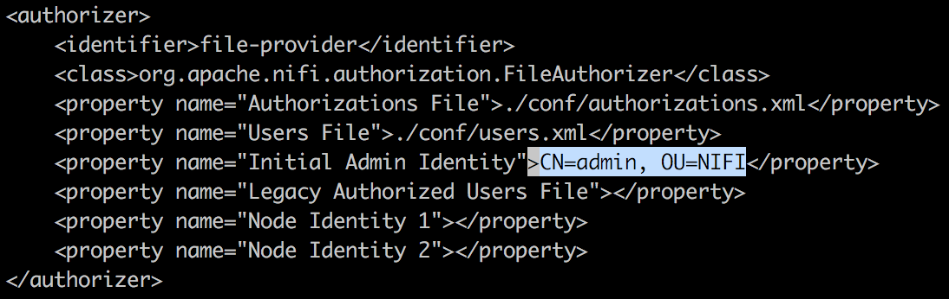
Initial Admin Identity
When you setup a secured NiFi instance for the first time, you must manually designate an “Initial Admin Identity”.
This initial admin user is granted access to the UI and given the ability to create additional users, groups, and policies.
You can Manually add it in “authorizers.xml” file or use Ambari to update the same.
Restart NiFi once updated.
Configure Initial Admin Manually
Configure Initial Admin via Ambari
Notes:
mInitial Admin Identity
When you setup a secured NiFi instance for the first time, you must manually designate an “Initial Admin Identity”.
This initial admin user is granted access to the UI and given the ability to create additional users, groups, and policies.
You can Manually add it in “authorizers.xml” file or use Ambari to update the same.
This property is only used when there are no other users, groups, and policies defined.
1

Slide 37
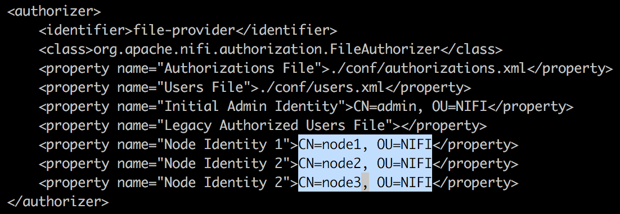
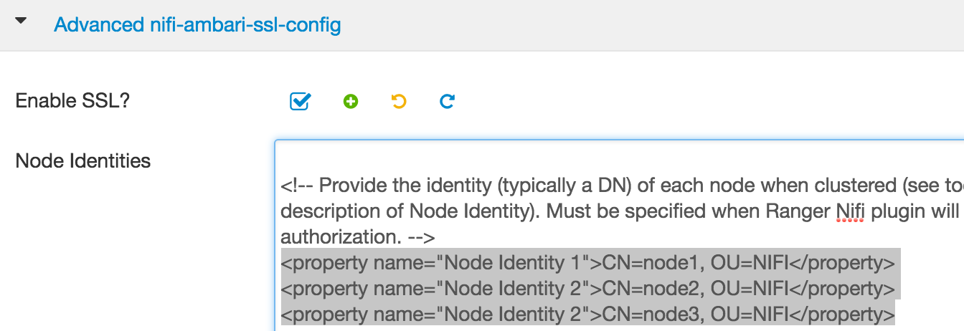
Node Identity
The identity of a NiFi cluster node.
When clustered, a property for each node should be defined, so that every node knows about every other node.
The authorization policies required for the nodes to communicate are created during startup.
If not clustered, these properties can be ignored.
If Using Ranger you can ignore these. Restart NiFi once updated.
Configure node identity Manually
Configure node identity via Ambari
Notes:
1

Slide 38
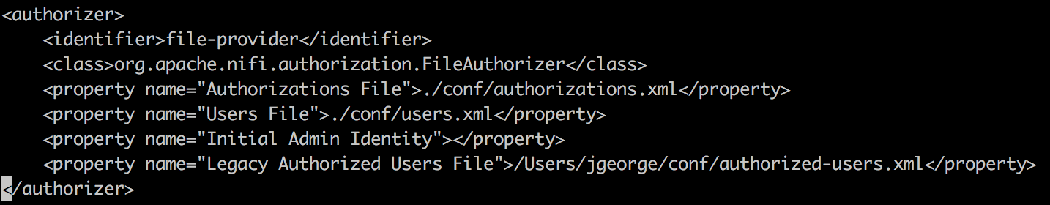
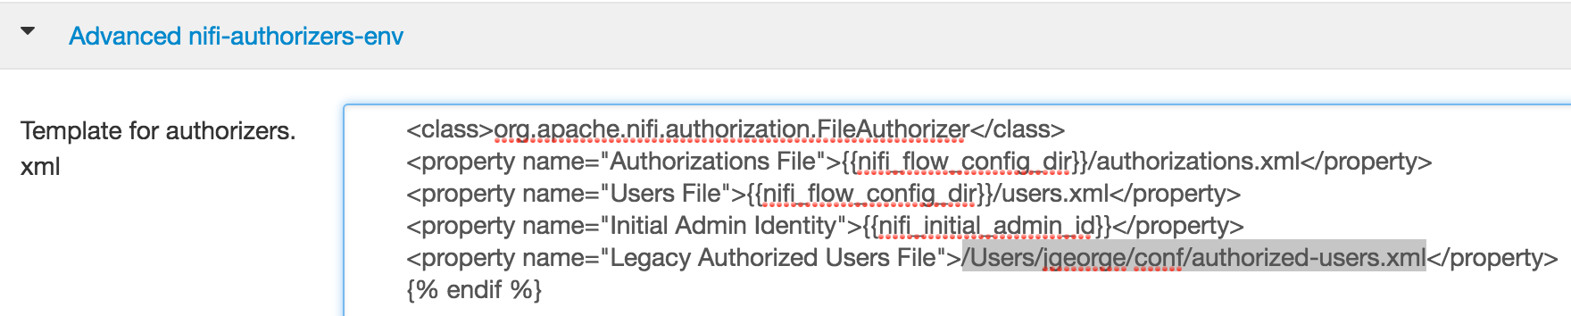
Legacy Authorized Users (Only for NiFi Upgrade)
If you are upgrading from a 0.x NiFi instance, you can convert your previously configured users and roles to the multi-tenant authorization model.
In the authorizers.xml file, specify the location of your existing authorized-users.xml file in the “Legacy Authorized Users File” property.
Once NiFi is restarted, users who previously had a legacy Administrator role can access the UI and begin managing users, groups, and policies.
Configure Legacy Users Manually
Configure node identity via Ambari
Notes:
If you are upgrading from a 0.x NiFi instance, you can convert your previously configured users and roles to the multi-tenant authorization model.
In the authorizers.xml file, specify the location of your existing authorized-users.xml file in the “Legacy Authorized Users File” property.
Once NiFi is restarted, users who previously had a legacy Administrator role can access the UI and begin managing users, groups, and policies.
1

Slide 39
LDAP User Authentication

Slide 40
LDAP User Authentication
NiFi supports user authentication via client certificates or via username/password.
Username/password authentication is performed by a Login Identity Provider.
The Login Identity Provider is a pluggable mechanism for authenticating users via their username/password.
Which Login Identity Provider to use is configured in two properties in the nifi.properties file.
nifi.login.identity.provider.configuration.file : property specifies the configuration file for Login Identity Providers.
nifi.security.user.login.identity.provider : property indicates which of the configured Login Identity Provider should be used.
Set nifi.security.user.login.identity.provider=ldap-provider to use LDAP authentication
NiFi does not perform user authentication over HTTP. Using HTTP all users will be granted all roles.
You can Configure It Manually or via Ambari
Notes:
LDAP User Authentication
NiFi supports user authentication via client certificates or via username/password.
Username/password authentication is performed by a Login Identity Provider.
The Login Identity Provider is a pluggable mechanism for authenticating users via their username/password.
Which Login Identity Provider to use is configured in two properties in the nifi.properties file.
nifi.login.identity.provider.configuration.file : property specifies the configuration file for Login Identity Providers.
nifi.security.user.login.identity.provider : property indicates which of the configured Login Identity Provider should be used.
Set nifi.security.user.login.identity.provider=ldap-provider to use LDAP authentication
NiFi does not perform user authentication over HTTP. Using HTTP all users will be granted all roles.
Below is an example and description of configuring a Login Identity Provider that integrates with a Directory Server to authenticate users.
<provider>
<identifier>ldap-provider</identifier>
<class>org.apache.nifi.ldap.LdapProvider</class>
<property name="Authentication Strategy">START_TLS</property>
<property name="Manager DN"></property>
<property name="Manager Password"></property>
<property name="TLS - Keystore"></property>
<property name="TLS - Keystore Password"></property>
<property name="TLS - Keystore Type"></property>
<property name="TLS - Truststore"></property>
<property name="TLS - Truststore Password"></property>
<property name="TLS - Truststore Type"></property>
<property name="TLS - Client Auth"></property>
<property name="TLS - Protocol"></property>
<property name="TLS - Shutdown Gracefully"></property>
<property name="Referral Strategy">FOLLOW</property>
<property name="Connect Timeout">10 secs</property>
<property name="Read Timeout">10 secs</property>
<property name="Url"></property>
<property name="User Search Base"></property>
<property name="User Search Filter"></property>
<property name="Authentication Expiration">12 hours</property>
</provider>
1

Slide 41
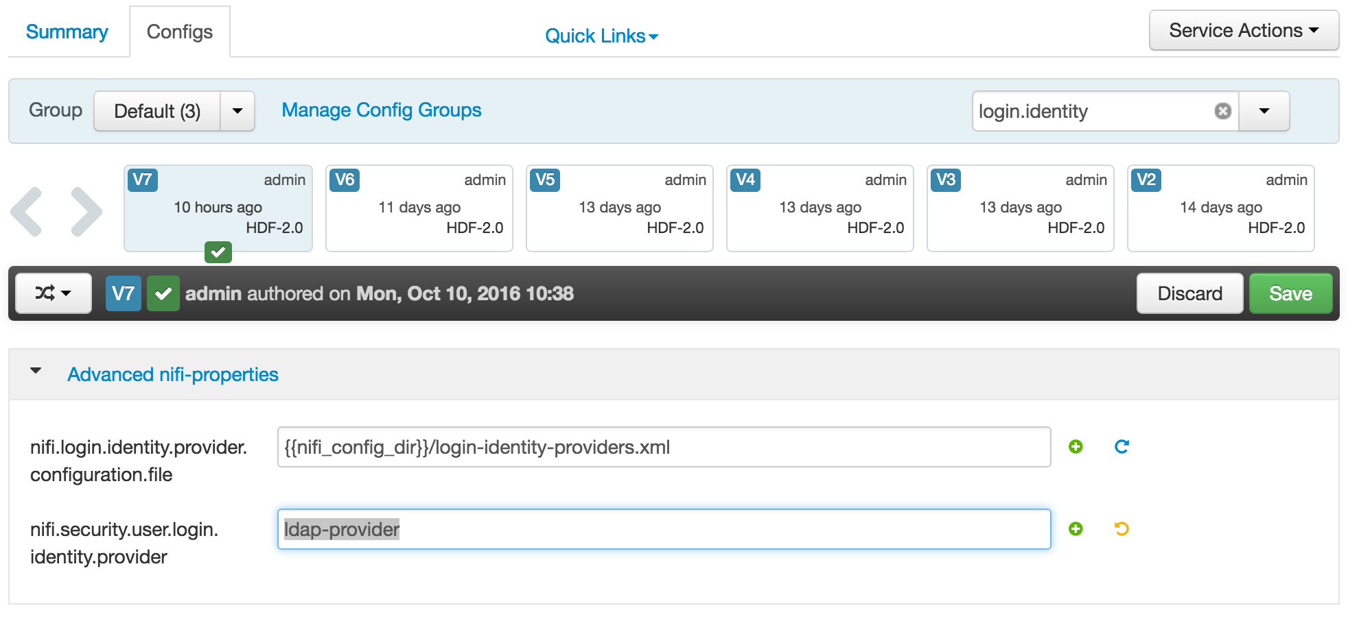
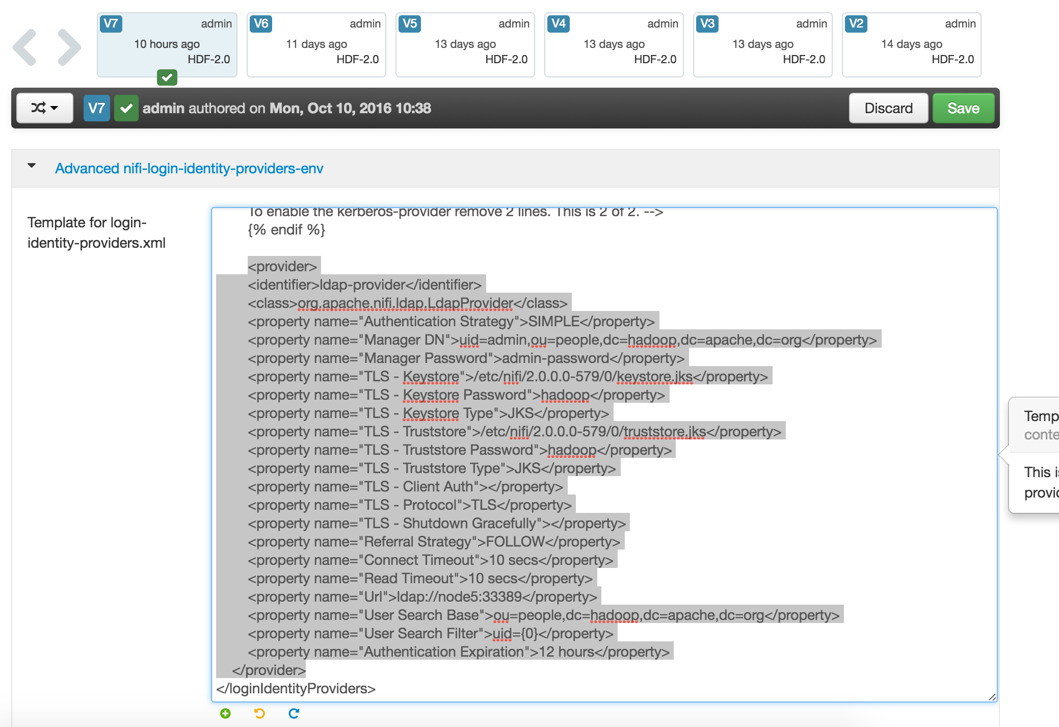
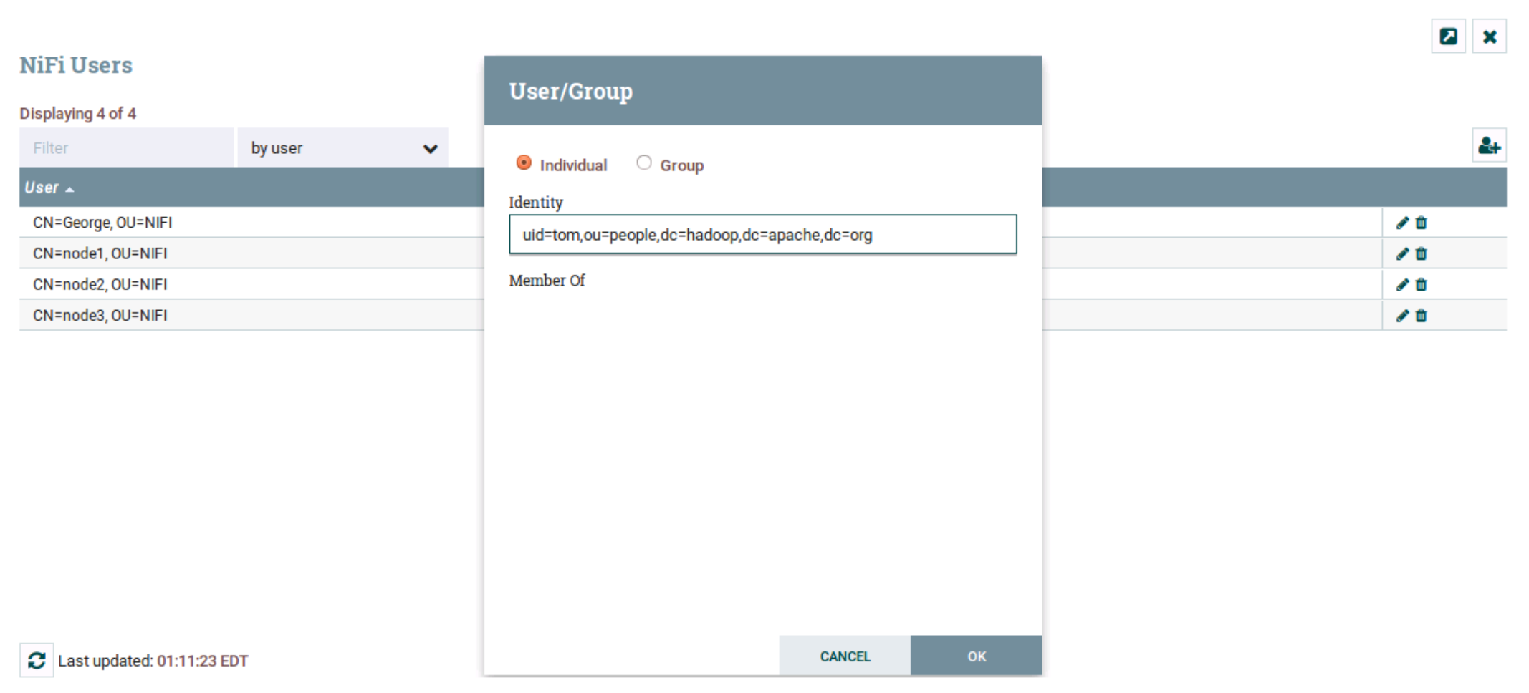
LDAP User Authentication
Configure login identity details, details to connect to ldap server
Set login identity provider as ldap
Restart NiFi, login as admin and create User in NiFi and assign rules.
Notes:
LDAP User Authentication
NiFi supports user authentication via client certificates or via username/password.
Username/password authentication is performed by a Login Identity Provider.
The Login Identity Provider is a pluggable mechanism for authenticating users via their username/password.
Which Login Identity Provider to use is configured in two properties in the nifi.properties file.
nifi.login.identity.provider.configuration.file : property specifies the configuration file for Login Identity Providers.
nifi.security.user.login.identity.provider : property indicates which of the configured Login Identity Provider should be used.
Set nifi.security.user.login.identity.provider=ldap-provider to use LDAP authentication
NiFi does not perform user authentication over HTTP. Using HTTP all users will be granted all roles.
Below is an example and description of configuring a Login Identity Provider that integrates with a Directory Server to authenticate users.
<provider>
<identifier>ldap-provider</identifier>
<class>org.apache.nifi.ldap.LdapProvider</class>
<property name="Authentication Strategy">START_TLS</property>
<property name="Manager DN"></property>
<property name="Manager Password"></property>
<property name="TLS - Keystore"></property>
<property name="TLS - Keystore Password"></property>
<property name="TLS - Keystore Type"></property>
<property name="TLS - Truststore"></property>
<property name="TLS - Truststore Password"></property>
<property name="TLS - Truststore Type"></property>
<property name="TLS - Client Auth"></property>
<property name="TLS - Protocol"></property>
<property name="TLS - Shutdown Gracefully"></property>
<property name="Referral Strategy">FOLLOW</property>
<property name="Connect Timeout">10 secs</property>
<property name="Read Timeout">10 secs</property>
<property name="Url"></property>
<property name="User Search Base"></property>
<property name="User Search Filter"></property>
<property name="Authentication Expiration">12 hours</property>
</provider>
1

Slide 42
LDAP User Authentication Configuration
Property Name | Description
Authentication Strategy | How the connection to the LDAP server is authenticated.
Manager DN | The DN of the manager that is used to bind to the LDAP server to search for users.
Manager Password | The password of the manager that is used to bind to the LDAP server to search for users.
TLS - Keystore | Path to the Keystore that is used when connecting to LDAP using START_TLS.
TLS - Keystore Password | Password for the Keystore that is used when connecting to LDAP using START_TLS.
TLS - Keystore Type | Type of the Keystore that is used when connecting to LDAP using START_TLS (i.e. JKS or PKCS12).
TLS - Truststore | Path to the Truststore that is used when connecting to LDAP using START_TLS.
TLS - Truststore Password | Password for the Truststore that is used when connecting to LDAP using START_TLS.
TLS - Truststore Type | Type of the Truststore that is used when connecting to LDAP using START_TLS (i.e. JKS or PKCS12).
TLS - Client Auth | Client authentication policy when connecting to LDAP using START_TLS.
TLS - Protocol | Protocol to use when connecting to LDAP using START_TLS. (i.e. TLS, TLSv1.1, TLSv1.2, etc).
TLS - Shutdown Gracefully | Specifies whether the TLS should be shut down gracefully before the target context is closed. Defaults to false.
Referral Strategy | Strategy for handling referrals. Possible values are FOLLOW, IGNORE, THROW.
Url | Url of the LDAP servier (i.e. ldap://<hostname>:<port>).
User Search Base | Base DN for searching for users (i.e. CN=Users,DC=example,DC=com).
Notes:
LDAP User Authentication Configuration – ALL Properties
Authentication Strategy - How the connection to the LDAP server is authenticated. Possible values are ANONYMOUS, SIMPLE, or START_TLS.
Manager DN - The DN of the manager that is used to bind to the LDAP server to search for users.
Manager Password - The password of the manager that is used to bind to the LDAP server to search for users.
TLS - Keystore - Path to the Keystore that is used when connecting to LDAP using START_TLS.
TLS - Keystore Password - Password for the Keystore that is used when connecting to LDAP using START_TLS.
TLS - Keystore Type - Type of the Keystore that is used when connecting to LDAP using START_TLS (i.e. JKS or PKCS12).
TLS - Truststore - Path to the Truststore that is used when connecting to LDAP using START_TLS.
TLS - Truststore Password - Password for the Truststore that is used when connecting to LDAP using START_TLS.
TLS - Truststore Type - Type of the Truststore that is used when connecting to LDAP using START_TLS (i.e. JKS or PKCS12).
TLS - Client Auth - Client authentication policy when connecting to LDAP using START_TLS. Possible values are REQUIRED, WANT, NONE.
TLS - Protocol - Protocol to use when connecting to LDAP using START_TLS. (i.e. TLS, TLSv1.1, TLSv1.2, etc).
TLS - Shutdown Gracefully - Specifies whether the TLS should be shut down gracefully before the target context is closed. Defaults to false.
Referral Strategy - Strategy for handling referrals. Possible values are FOLLOW, IGNORE, THROW.
Connect Timeout - Duration of connect timeout. (i.e. 10 secs).
Read Timeout - Duration of read timeout. (i.e. 10 secs).
Url - Url of the LDAP servier (i.e. ldap://<hostname>:<port>).
User Search Base - Base DN for searching for users (i.e. CN=Users,DC=example,DC=com).
1

Slide 43
Kerberos User Authentication

Slide 44
Kerberos User Authentication
NiFi can be configured to use Kerberos SPNEGO (or "Kerberos Service") for authentication
NiFi will only respond to Kerberos SPNEGO negotiation over an HTTPS connection.
Which Login Identity Provider to use is configured in two properties in the nifi.properties file.
Set nifi.security.user.login.identity.provider=kerberos-provider to use Kerberos authentication.
Set nifi.login.identity.provider.configuration.file=./conf/login-identity-providers.xml to point to login identity provider file.
Property Name | Description
nifi.kerberos.krb5.file | The location of the krb5 file. [eg: /etc/krb5.conf]
nifi.kerberos.service.principal | The name of the NiFi Kerberos service principal. [ eg: nifi/HDF@EXAMPLE.COM]
nifi.kerberos.keytab.location | The file path of the NiFi Kerberos keytab. [ eg: /opt/nifi-HDF.keytab]
nifi.kerberos.authentication.expiration | The expiration duration of a Kerberos user authentication. [eg:12 hrs]
Notes:
1

Slide 45
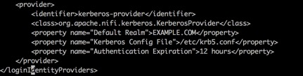
Manually Configuring Kerberos User Authentication
Below is an example and description of configuring a Login Identity Provider that integrates with a Kerberos Key Distribution Center (KDC) to authenticate users.
Configure ./conf/login-identity-providers.xml as below to enable username/password authentication.
Set Below property in nifi.properties
nifi.security.user.login.identity.provider=kerberos-provider
Notes:
Below is an example and description of configuring a Login Identity Provider that integrates with a Kerberos Key Distribution Center (KDC) to authenticate users.
Configure ./conf/login-identity-providers.xml as below to enable username/password authentication.
<provider>
<identifier>kerberos-provider</identifier>
<class>org.apache.nifi.kerberos.KerberosProvider</class>
<property name="Default Realm">NIFI.APACHE.ORG</property>
<property name="Kerberos Config File">/etc/krb5.conf</property>
<property name="Authentication Expiration">12 hours</property>
</provider>
1

Slide 46
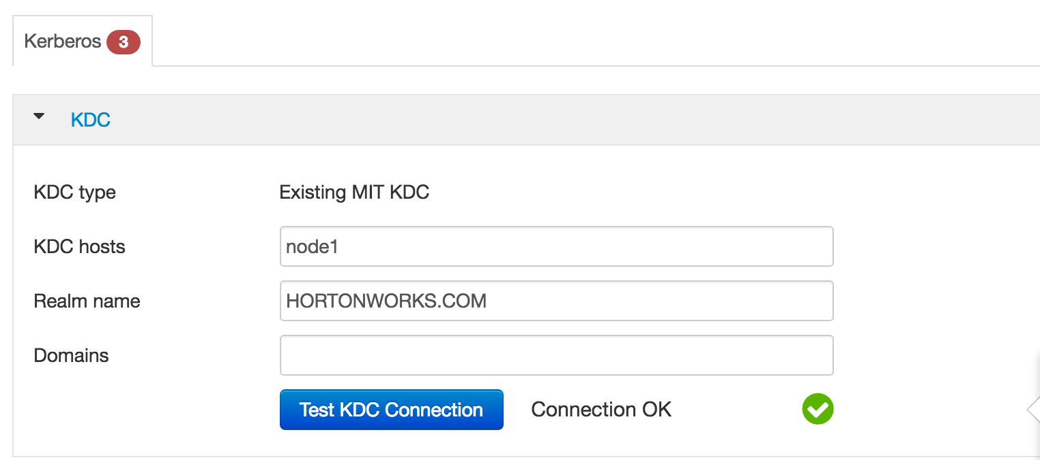
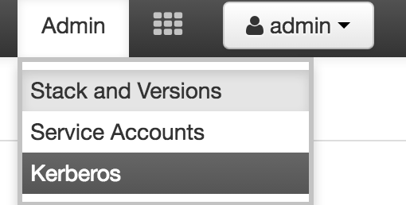
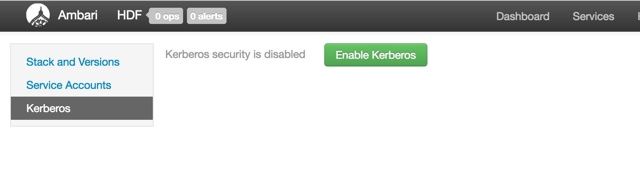
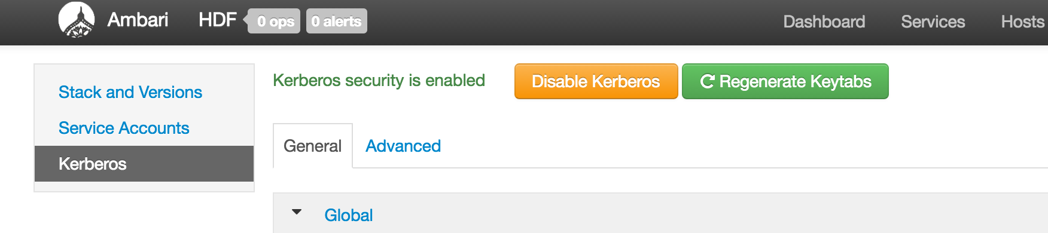
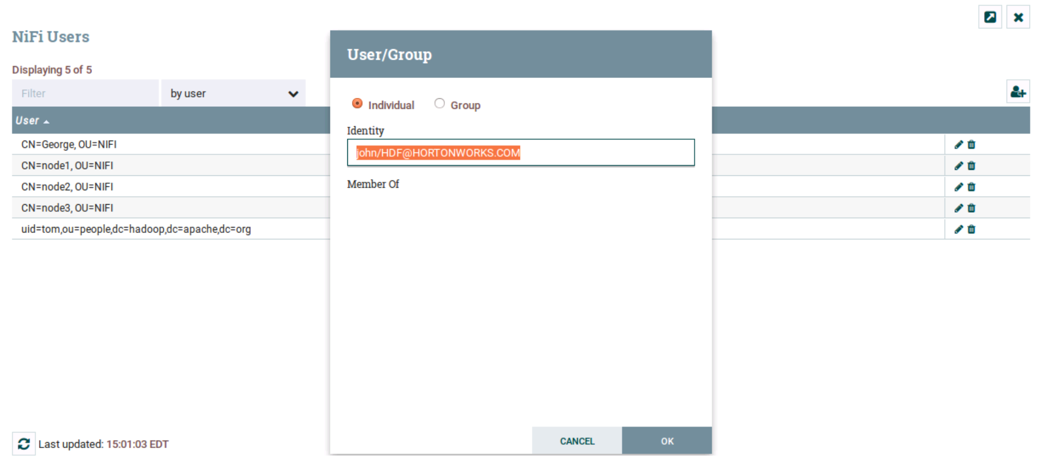
Enabling Kerberos User Authentication via Ambari
Configure KDC and proceed till enabled
Enable Kerberos from Ambari
As admin add Kerberos users in
NiFi and provide access policies, and can login now.
Complete Kerberos Enablement
Notes:
1

Slide 47
Security: HDF Authorization and Multi-Tenancy

Slide 48
Enabling Authentication & Authorization
Authorization Support Starting HDF-2.0:
File Based Policies (NiFi Managed)
Ranger Policies
Notes:
Hortonworks: Powering the Future of Data
1

Slide 49
HDF 3.0 – NiFi Managed Authorizer vs. External Authorizer
Managed Authorizer
File based persistence
Could be be extended to other persistence mechanisms
NiFi UI to manage policies
NiFi controls authorization logic
External Authorizer
Ranger integration
Ranger UI to manage policies
Ranger controls authorization logic

Slide 50
HDF 3.0 - Authorization Model
HDF 2.0 introduces a new delegated authorization model
Delegate authorization to a pluggable Authorizer interface
AuthorizationResult authorize(AuthorizationRequest request)
Authorize each request based on user identity, action, and resource
Example for user1 modifying properties on processor1:
User Identity: user1
Action: WRITE
Resource: processor1 (uuid)
Authorizer determines if the user can perform the action on the given resource
If authorizer says resource not found, parent is checked… if parent isn’t found, parent’s parent is checked, and so on…

Slide 51
Managed/File Based Authorizer

Slide 52
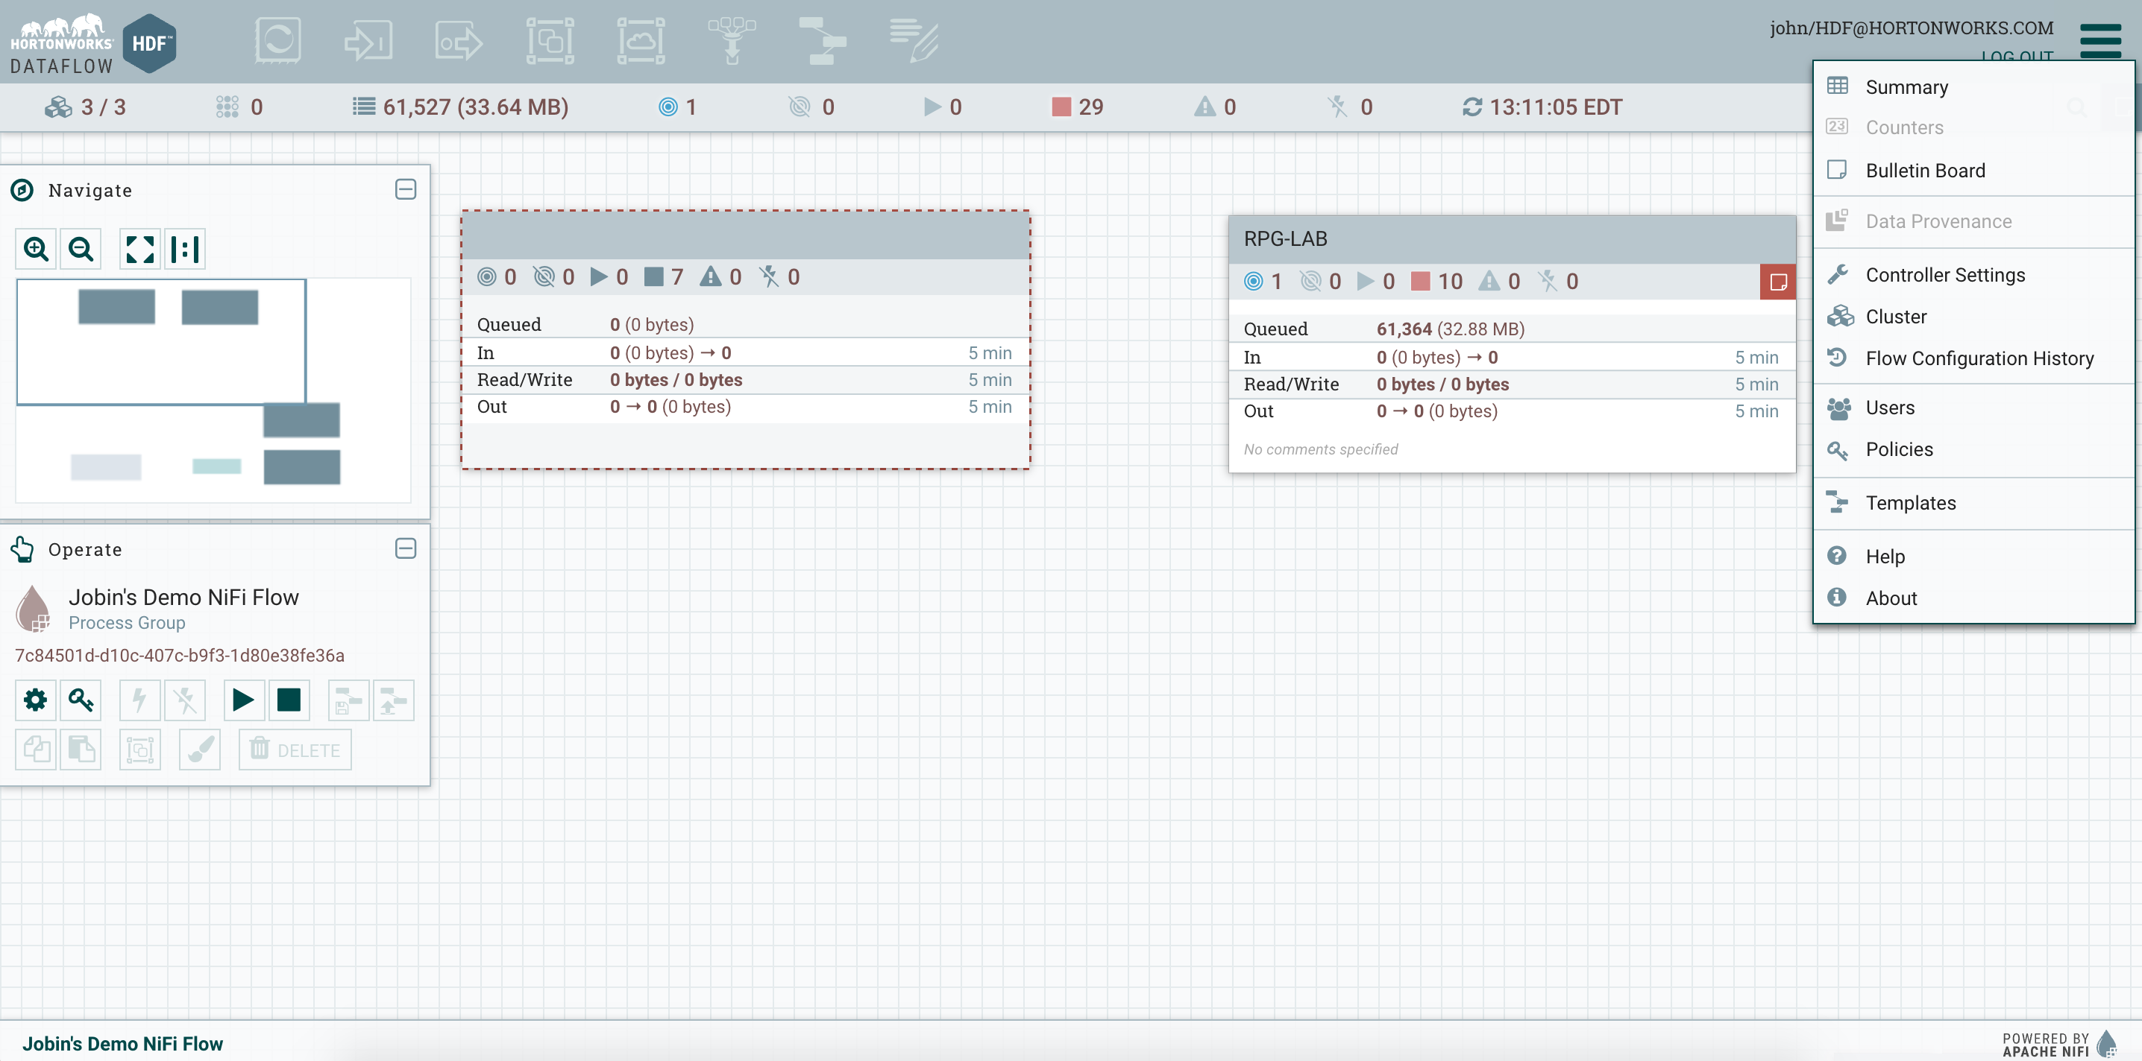
Secured UI Overview
Users Icon in Global Menu used to access Users/Groups
Selected root process group
Lock Icon in Global Menu used to access Global policies
Lock Icon in palette used to access policies for currently selected component

Slide 53
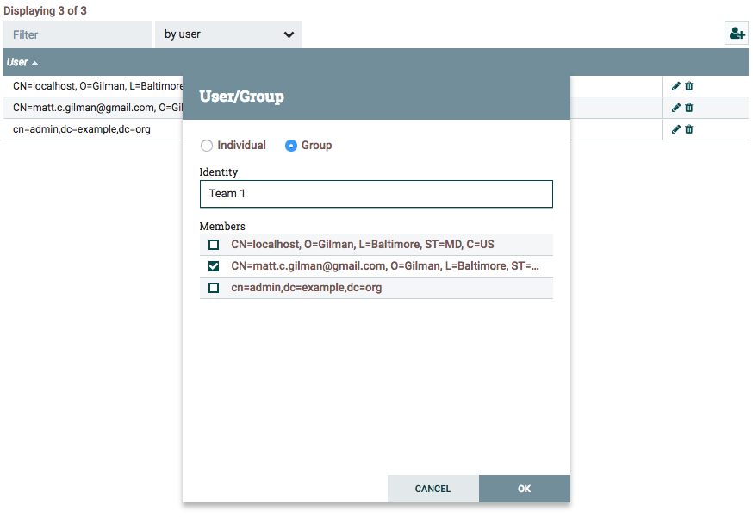
Secured NiFi - Managing Users
Clicking the new user icon allows the admin to create Users and Groups
Individual Users can be grouped
Groups can be assigned members
Clicking the edit user icon allows the admin to update a specific User/Group

Slide 54
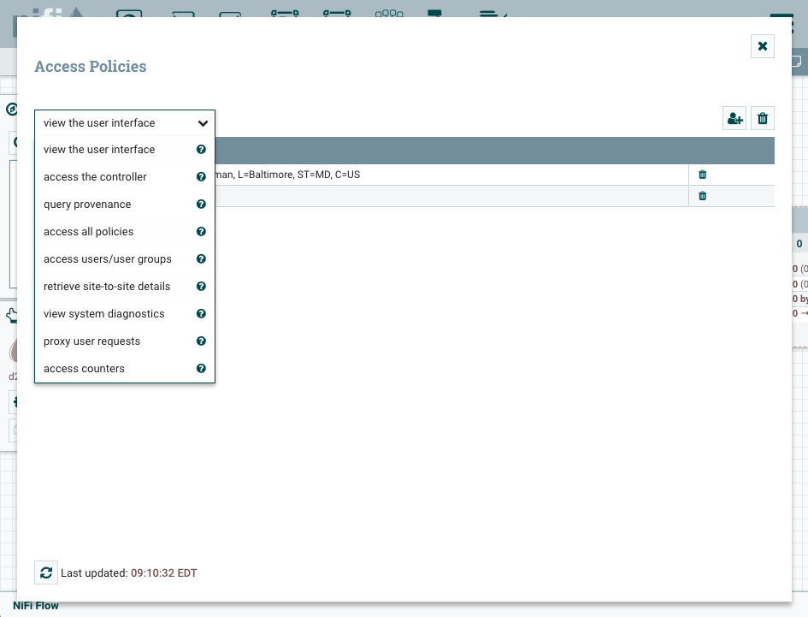
Managing Global Policies
Select the policy in question
Optionally select if the action is view or modify
Click the add user button to search for the desired User
Controller policies extend to Reporting Tasks and Controller level Service unless explicitly overridden
Global admin policies extend to all components (cannot be overridden)

Slide 55
Global Policies
Policy | Privilege | Global Menu Selection
view the UI | Allow users to view the UI | N/A
Access the controller | Allows users to view/modify the controller including Reporting Tasks, Controller Services, and Nodes in the Cluster | Controller Settings
Query provenance | Allows users to submit a Provenance Search and request Event Lineage | Data Provenance
Access restricted components | Allows users to create/modify restricted components assuming otherwise sufficient permissions | N/A
Access all policies | Allows users to view/modify the policies for all components | Policies
Access users/user groups | Allows users to view/modify the users and user groups | Users
Retrieve site-to-site details | Allows other NiFi instances to retrieve Site-To-Site details | N/A
View system diagnostics | Allows users to view System Diagnostics | Summary
Proxy user requests | Allows proxy machines to send requests on the behalf of others | N/A
Access counters | Allows users to view/modify Counters | Counters
Notes:
Hortonworks: Powering the Future of Data
1

Slide 56
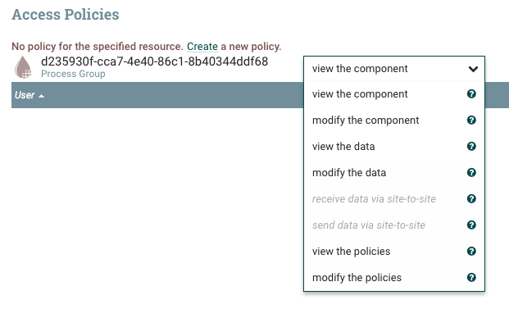
Managing Component Policies
Clicking the lock icon brings up policies for the selected component
Drop-down specifies the action
Click Create to define a new policy if none is defined, then add Users and Groups
Data policies require entire request chain to be authorized
Zero master clustering - User requests replicated through other nodes

Slide 57
Component Policies
Policy | Privilege
View the component | Allows users to view component configuration details
Modify the component | Allows users to modify component configuration details
View the data | Allows user to view metadata and content for this component through provenance data and flowfile queues in outbound connections
Modify the data | Allows user to empty flowfile queues in outbound connections and submit replays
View the policies | Allows users to view the list of users who can view/modify a component
Modify the policies | Allows users to modify the list of users who can view/modify a component
Receive data via site-to-site | Allows a port to receive data from NiFi instances
Send data via site-to-site | Allows a port to send data from NiFi instances
Notes:
Hortonworks: Powering the Future of Data
1

Slide 58
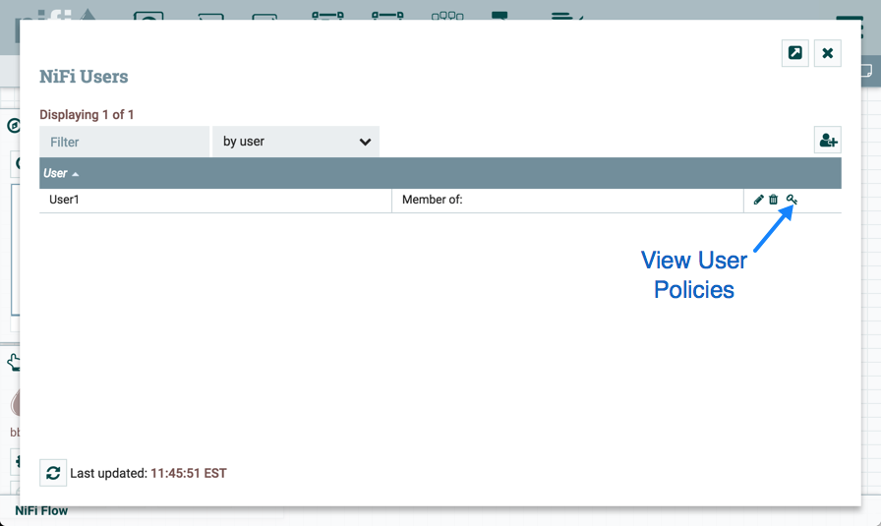
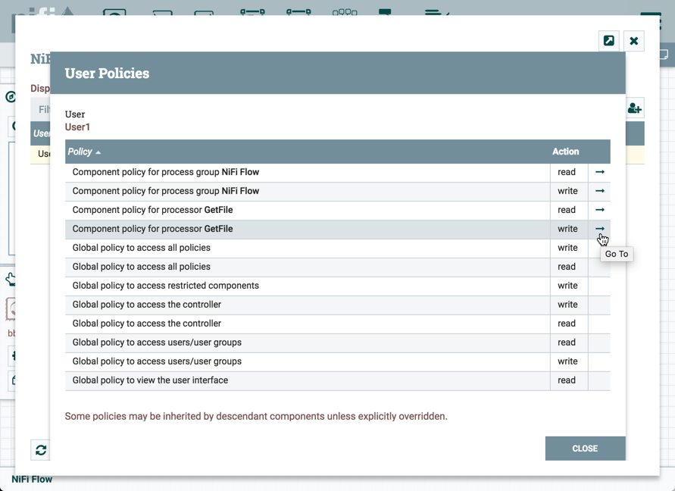
Viewing Policies on Users
From the UI, select “Users” from the Global Menu. This opens the NiFi Users dialog.
Select the View User Policies icon

Slide 59
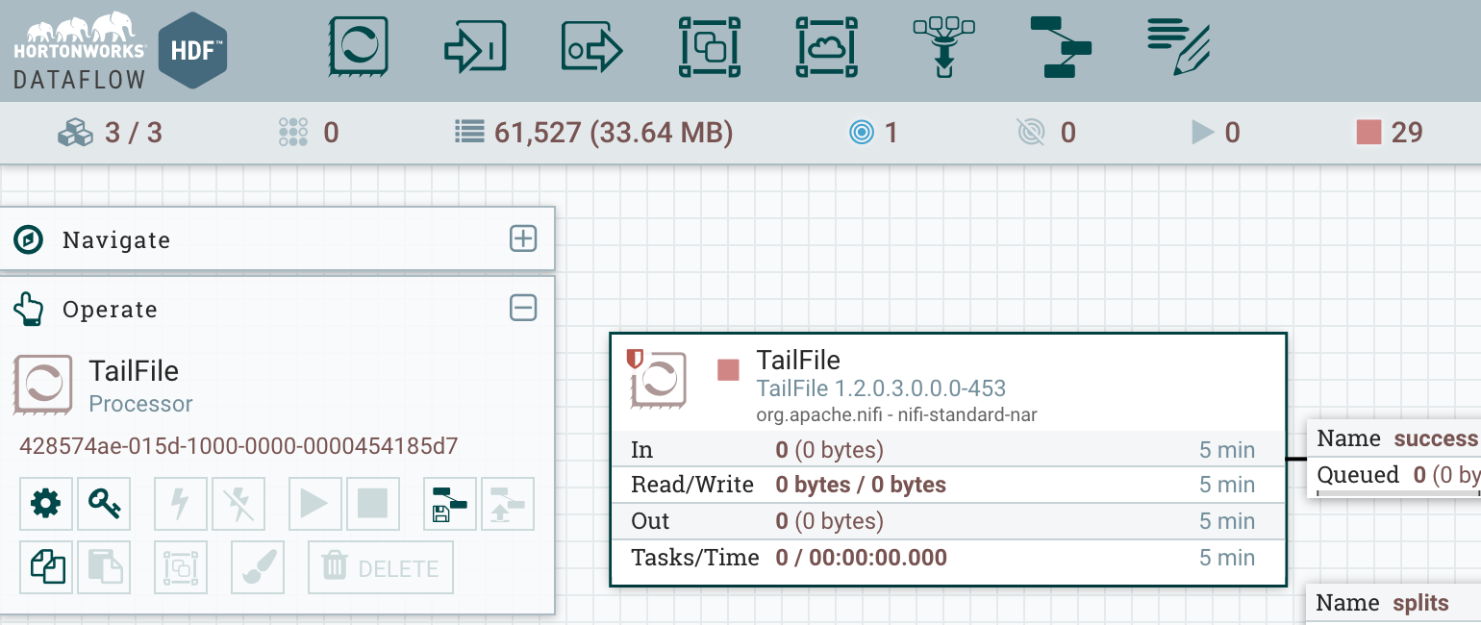
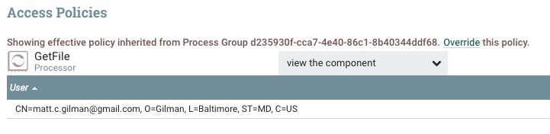
Overriding Component Policies
Component inherit policies from the closest ancestor Process Group with policies defined
View/Modify policies handled independently
Click Override to define a new policy, then add Users and Groups
New Users and Groups override the inherited policies (whitelisting)

Slide 60
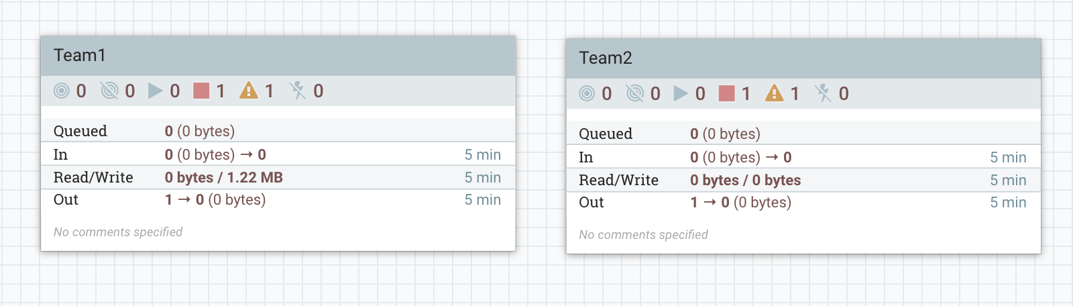
Multi-Tenancy Example
Assume two development teams – Team 1 and Team 2
Each team gets a Process Group and shouldn’t be able to interfere with other team

Slide 61
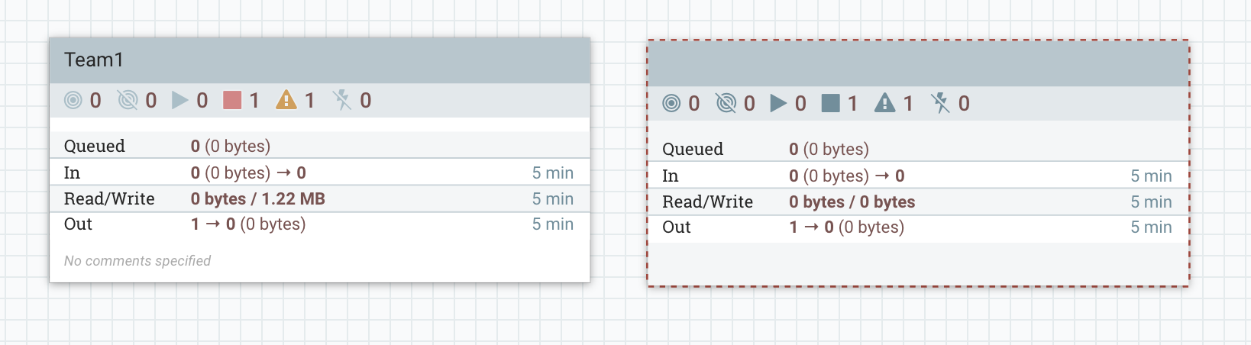
Multi-Tenancy Example
Create a Group for Team 1 and a Group for Team 2
Give Team 1 view & modify for Process Group 1
Give Team 2 view & modify for Process Group 2
A user from Team 1 would see:
Can’t see the name of the group and can’t right-click to configure the group, but can enter the group

Slide 62
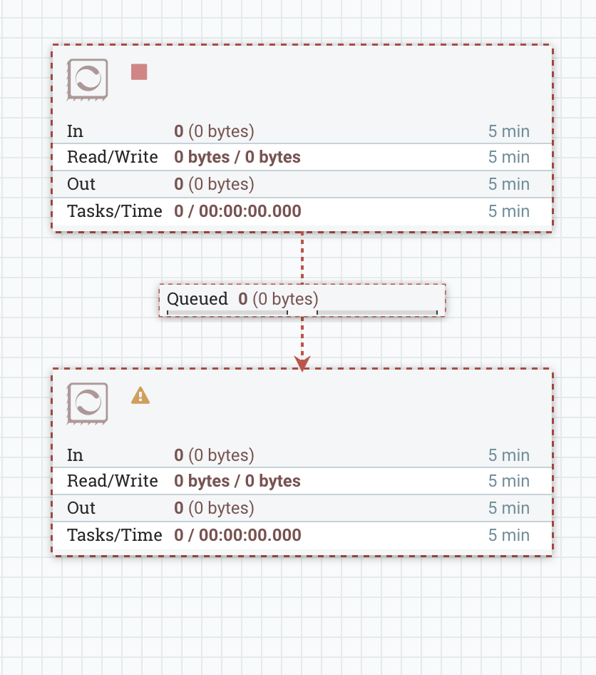
Multi-Tenancy Example
Inside Team2 Process Group
If the user from Team 1 entered the group for Team 2 they can see the structure of the dataflow and status but not any configuration
Processor type, properties, etc
All components underneath Team 2’s process group inherit the policies of the process group, unless more specific policies defined

Slide 63
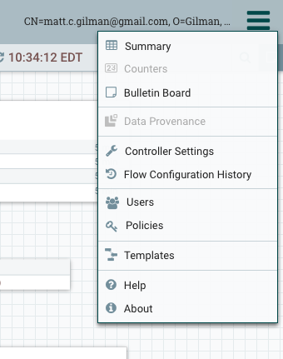
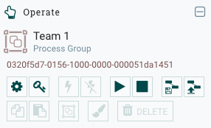
Additional changes to promote Multi-Tenancy
Controller level scoping for
Reporting Tasks
Controller Services
Introducing Process Group level scoping for
Templates
Controller Services

Slide 64
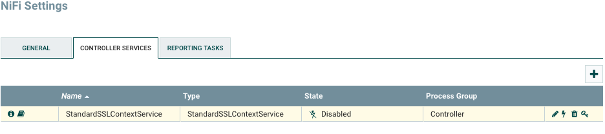
Controller Settings
Authorization based on policies for accessing the Controller
Can be overridden for a given Controller Service or Reporting Task
Controller Services defined here are accessible to Reporting Tasks
Are not accessible to components on the canvas

Slide 65
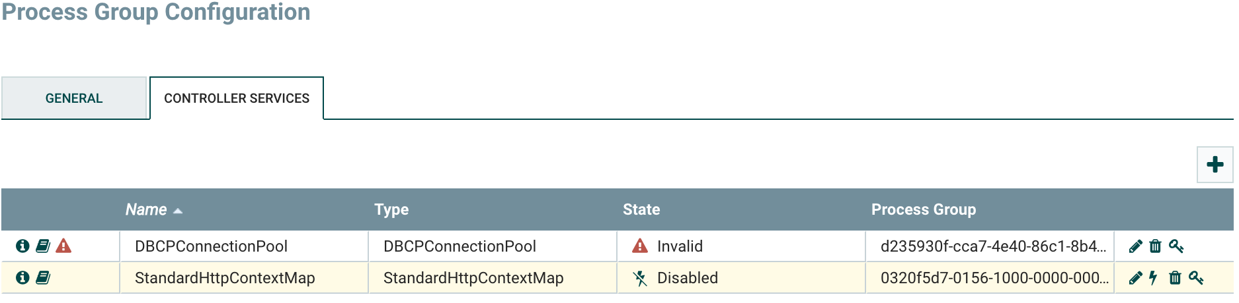
Process Group Settings
Authorization based on policies for accessing the Process Group
Can be overridden for a given Controller Service
Lists all Controller Services created in this Process Group and above (ancestor Process Groups)
Controller Services defined here are accessible to Processors in this Process Group and below (descendant Processors)

Slide 66
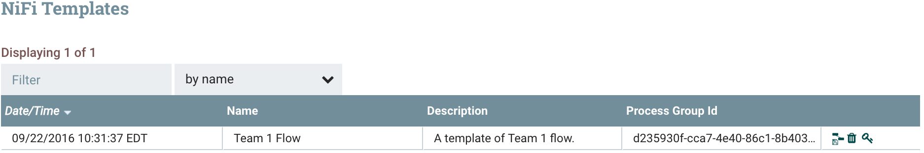
Templates
Templates stored per Process Group
Establishes base authorization but can be overridden
Available Template listing still accessed through the Global Menu
If authorized, a Template can be instantiated in any Process Group

Slide 67

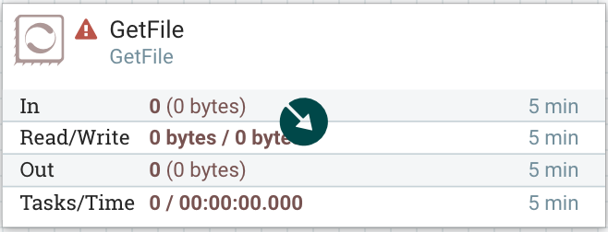
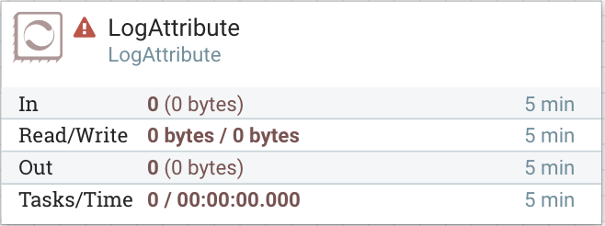
Revisions
Revision per component
Supports concurrent editing of different components without need for refreshing

Slide 68
External/Ranger Based Authorizer

Slide 69
Architecture: Authorization via Ranger-NiFi Plugin
Ranger-NiFi plugin supports policy management via Ranger for NiFi
Supports two-way communication for policy retrieval from Ranger (NiFi) and REST/Resources information from NiFi (Ranger)
Audits logged to Solr (Ambari Infra on HDF)
Can be used with/without Ambari
Apache Ranger
Policies
Audit Logs
Resource Lookup
Retrieve
Policies
Solr
Retrieve
Resources
NiFi
Ranger Authorizer
REST /resources
Policy Refresher
Policy Cache
Notes:
Hortonworks: Powering the Future of Data
1

Slide 70
HDF - Apache Ranger Integration
Apache Ranger provides a centralized platform to define, administer and manage security policies consistently across Hadoop components.
In the case of HDF, it enables the administrator to create/manage authorization policies for Kafka, Storm and Nifi from the same web interface (or REST APIs).
high level steps for NiFi Integration are:
Ranger install prerequisites
Ranger install
Update Nifi Ranger repo
Test Ranger plugin
Create Ranger users and policies
Test Nifi access as nifiadmin user
Notes:
Hortonworks: Powering the Future of Data
1

Slide 71
1. Ranger install prerequisites:
Make sure Logsearch or external Solr is installed/running before installing Ranger (used to store audits)
A MySQL, Oracle, or PostgreSQL database instance must be running and available to be used by Ranger.
Configure RDBMS for Ranger (used to store policies), set of RDBMS scripts.
Set up Ambari with Ranger database jars.
Notes:
Hortonworks: Powering the Future of Data
1

Slide 72
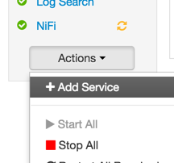
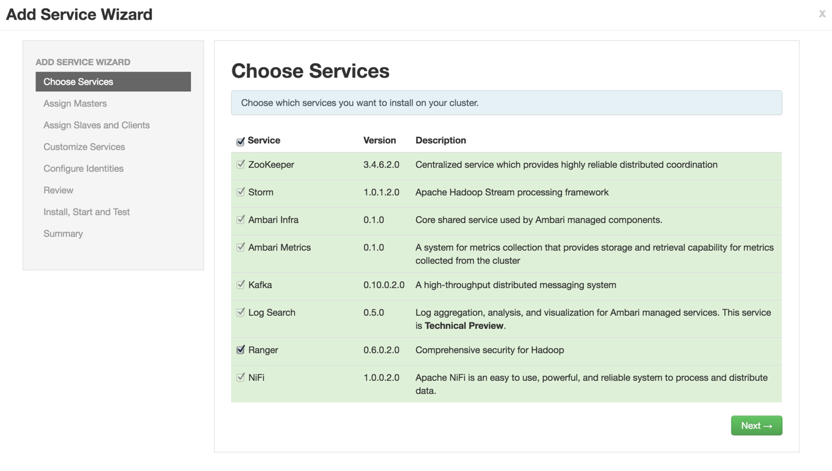
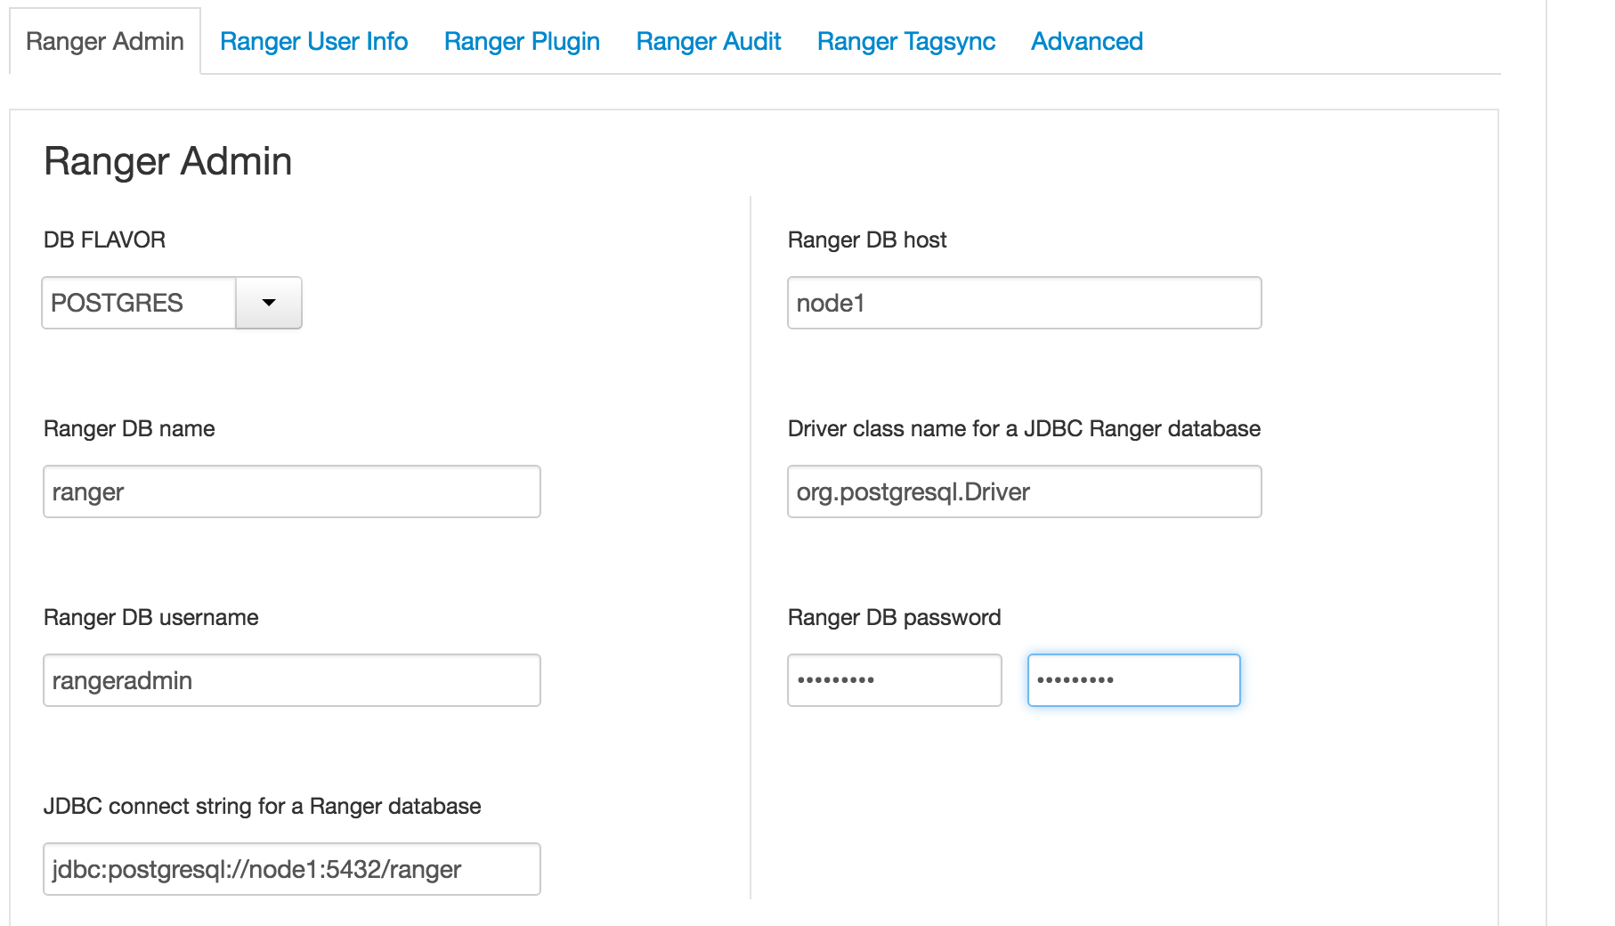
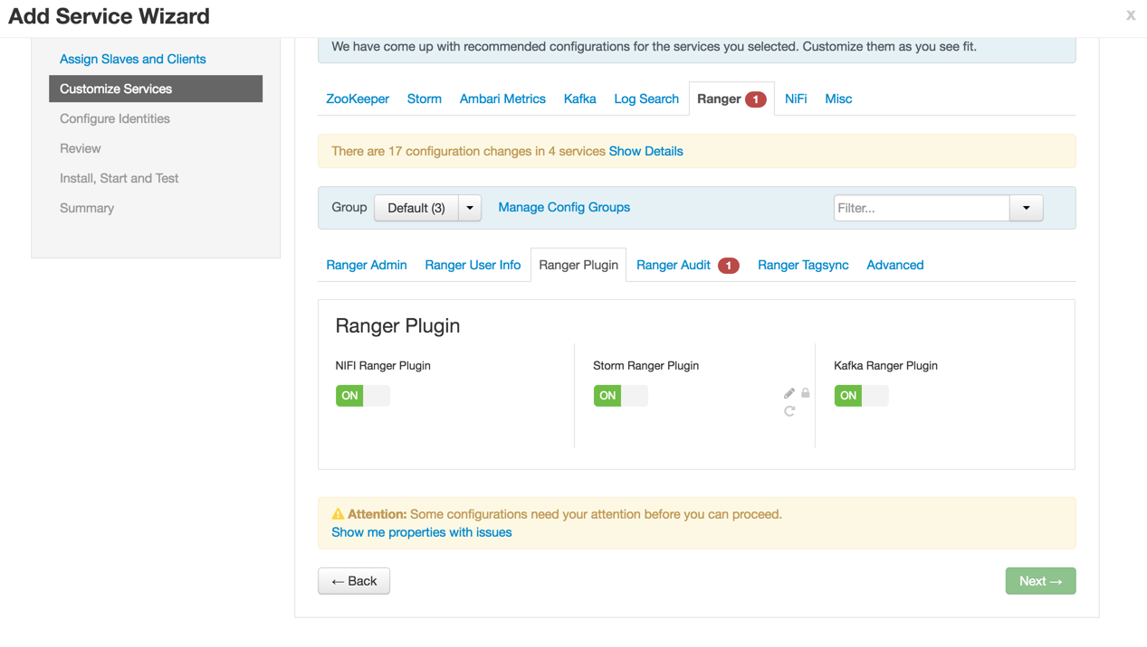
2. Ranger install:
Click Add Service
Select Ranger and click next
Configure Ranger plugin and Ranger Audit section. Click next to complete installation
Configure Ranger Admin, user sync section
Notes:
Hortonworks: Powering the Future of Data
1

Slide 73
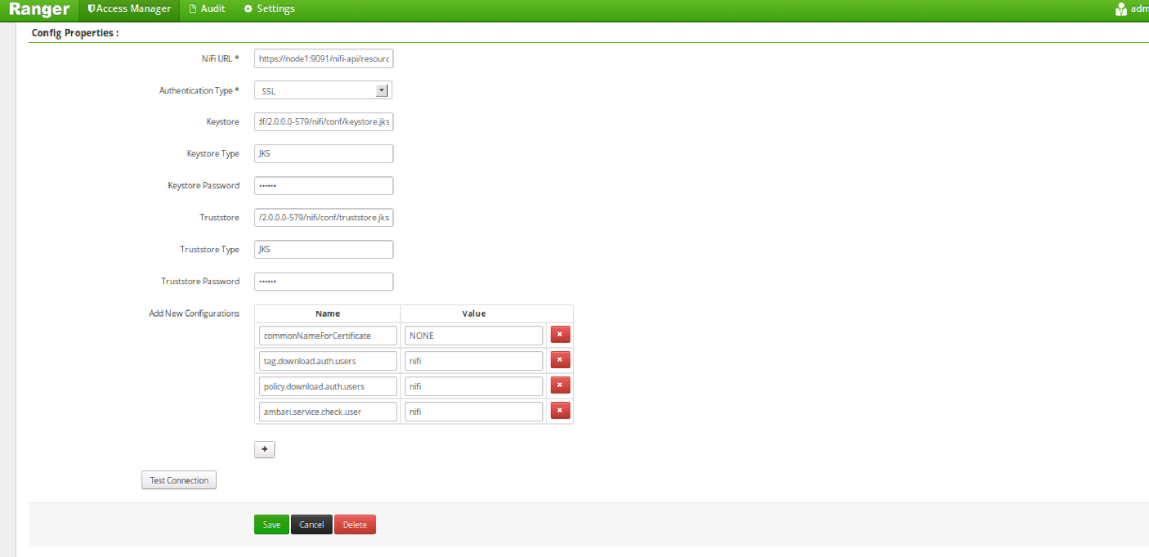
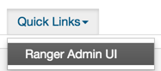
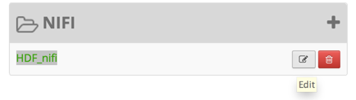
3. Update Nifi Ranger repo:
This is needed to enable auto-completion when creating policies in Ranger for Nifi.
Note that if this step is skipped, Ranger plugin will still work as usual - it just impacts lookups when creating Nifi policies from the Ranger web interface.
To access the Nifi repo in Ranger:
Ranger > Access Manager > Nifi > click Edit icon
Open Ranger UI from Ambari
Update the configs, test and save
Notes:
Hortonworks: Powering the Future of Data
1

Slide 74
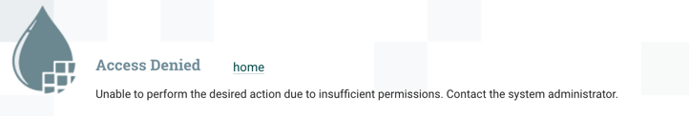
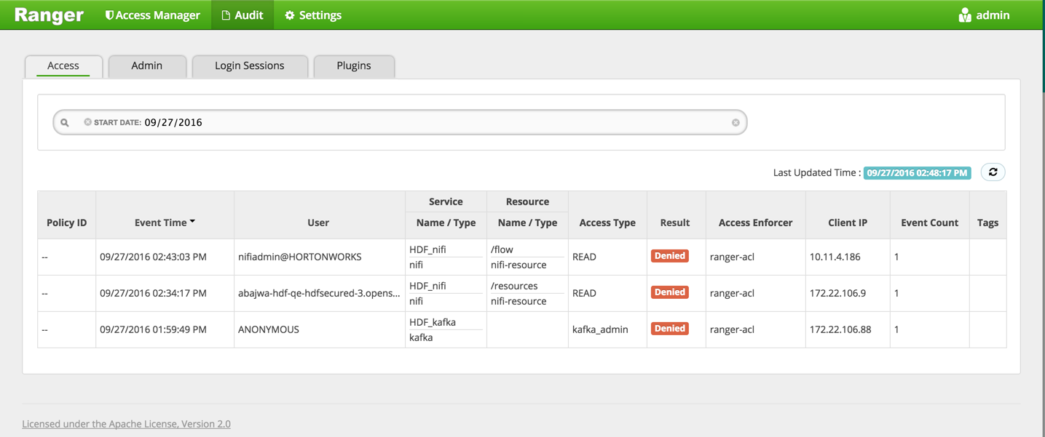
4. Test Ranger plugin:
First attempt to open Nifi UI results in "Access denied" due to insufficient permissions:
Navigate to the ‘Audit’ tab to verify Ranger Nifi plugin is working and auditing is done properly:
Notes:
Hortonworks: Powering the Future of Data
1

Slide 75

5. Create Ranger users and policies:
Create NiFi admin user, proxy users for each nodes in cluster and create policies for them to access NiFi UI.
Create/Sync Users in Ranger
Create Access policies for those users
Notes:
Hortonworks: Powering the Future of Data
1

Slide 76


6. Test Nifi access as nifiadmin user:
Note that it may take up to 30s after creating the policies in Ranger UI for them to take affect.
Now you could login in as admin user who was given privileges in ranger
Login as Admin user created in Ranger
You could see the audit log in ranger is populated with latest access.
Now you can add more users and policies for their access
Notes:
Hortonworks: Powering the Future of Data
1

